Slide 1

PROJECT PRESENTATION
DV1566: INTRODUCTION TO CLOUD COMPUTING
GROUP 18
JESWANTH NAIDU PADI
VISWAS SETTY
AYYAPPA MITTA

Slide 2

Contents:
Problem and Aim
Architecture
Creating IAM Roles
Creating VPC
Creating a Relational Database
Adding our PHP/DB data to the EC2 instance
Launching EC2 Instance
Attaching Application Load Balancer to the EC2
Creating an Auto-Scaling Group for the EC2
Stress Testing our web application

Slide 3

Problem :
Finding a user-friendly, customizable website or application that adds relevant articles to today’s demand is a struggle for many.
A user-friendly solution is required because current choices frequently lack accessibility and simplicity.
Aim :
To deploy a highly available and scalable Multi-Tier web application extensively using AWS services only.

Slide 4
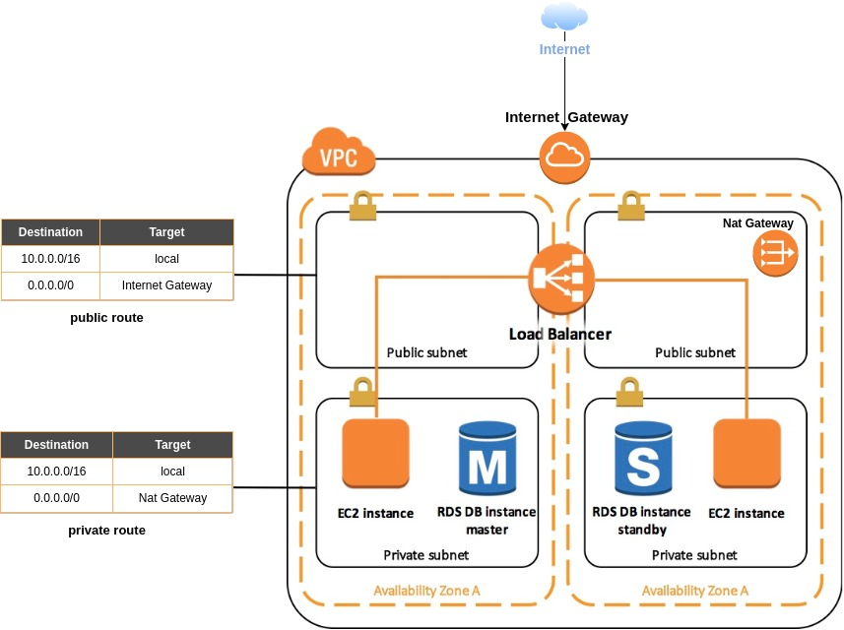
Architecture :
An external load balancer redirects the request from the internet to the Amazon EC2 servers.

Slide 5
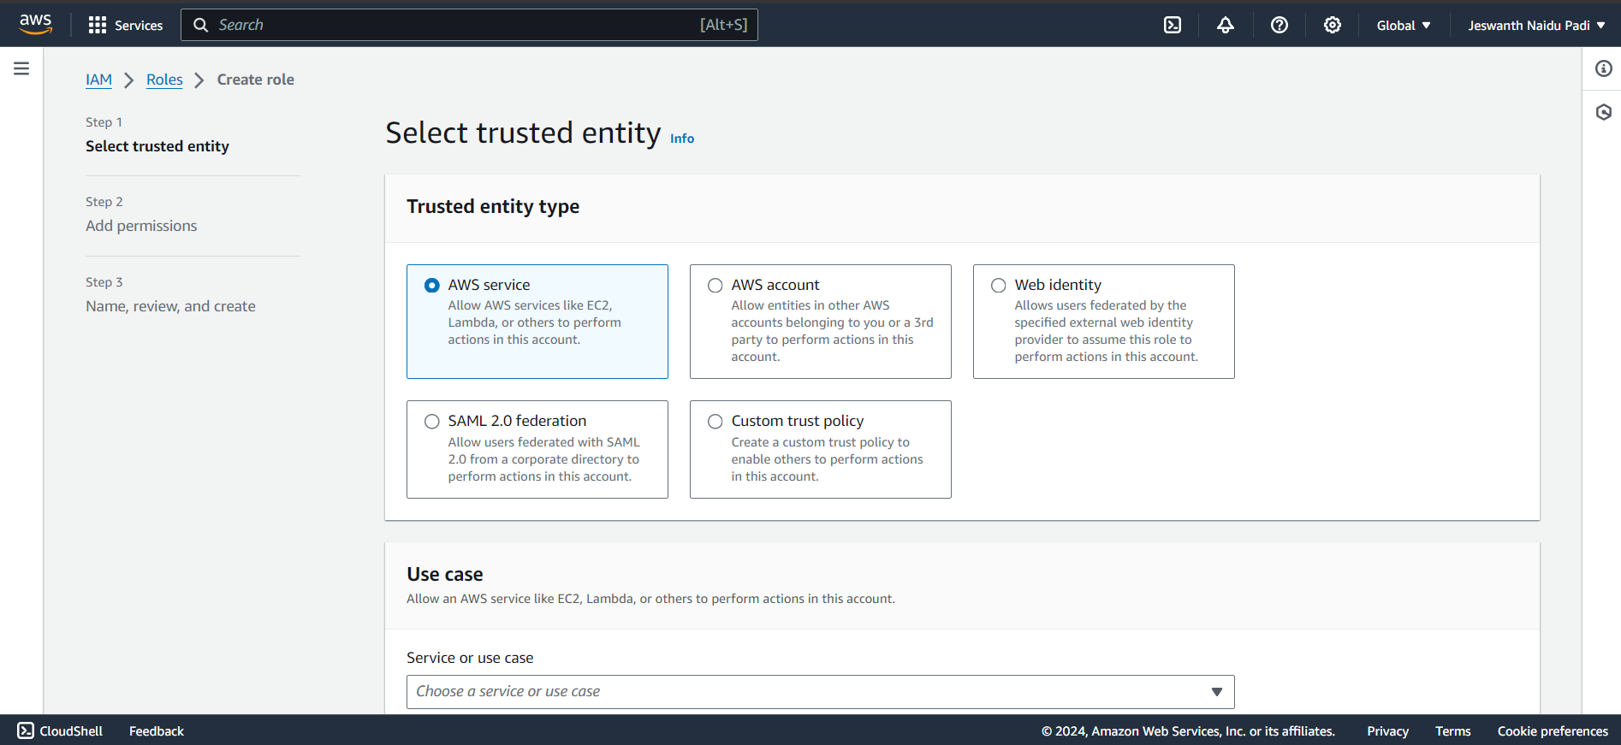
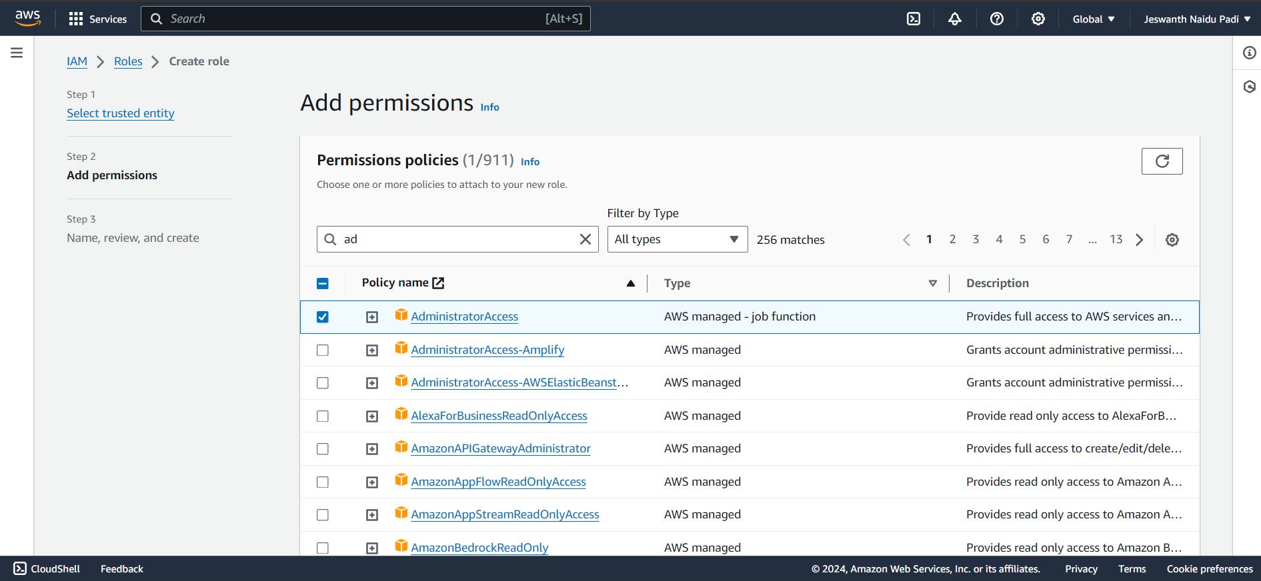
Creating IAM Roles:

Slide 6
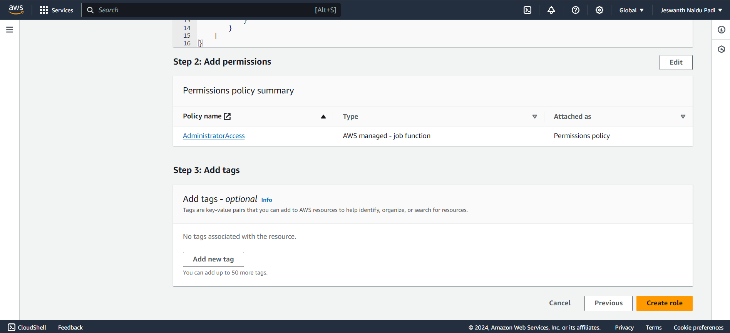
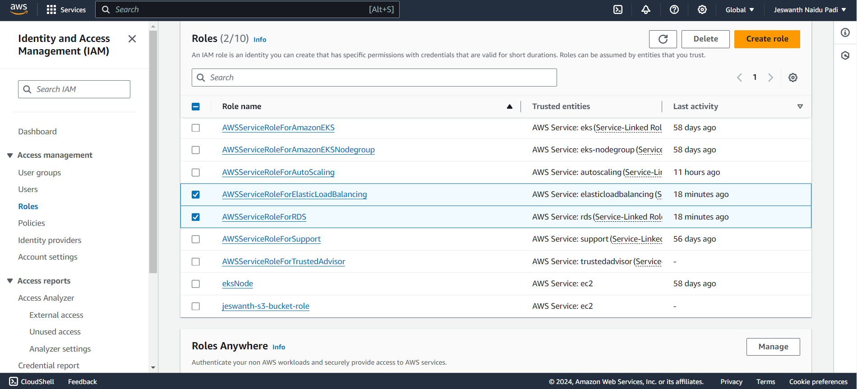
Attaching policies to the IAM Roles:

Slide 7
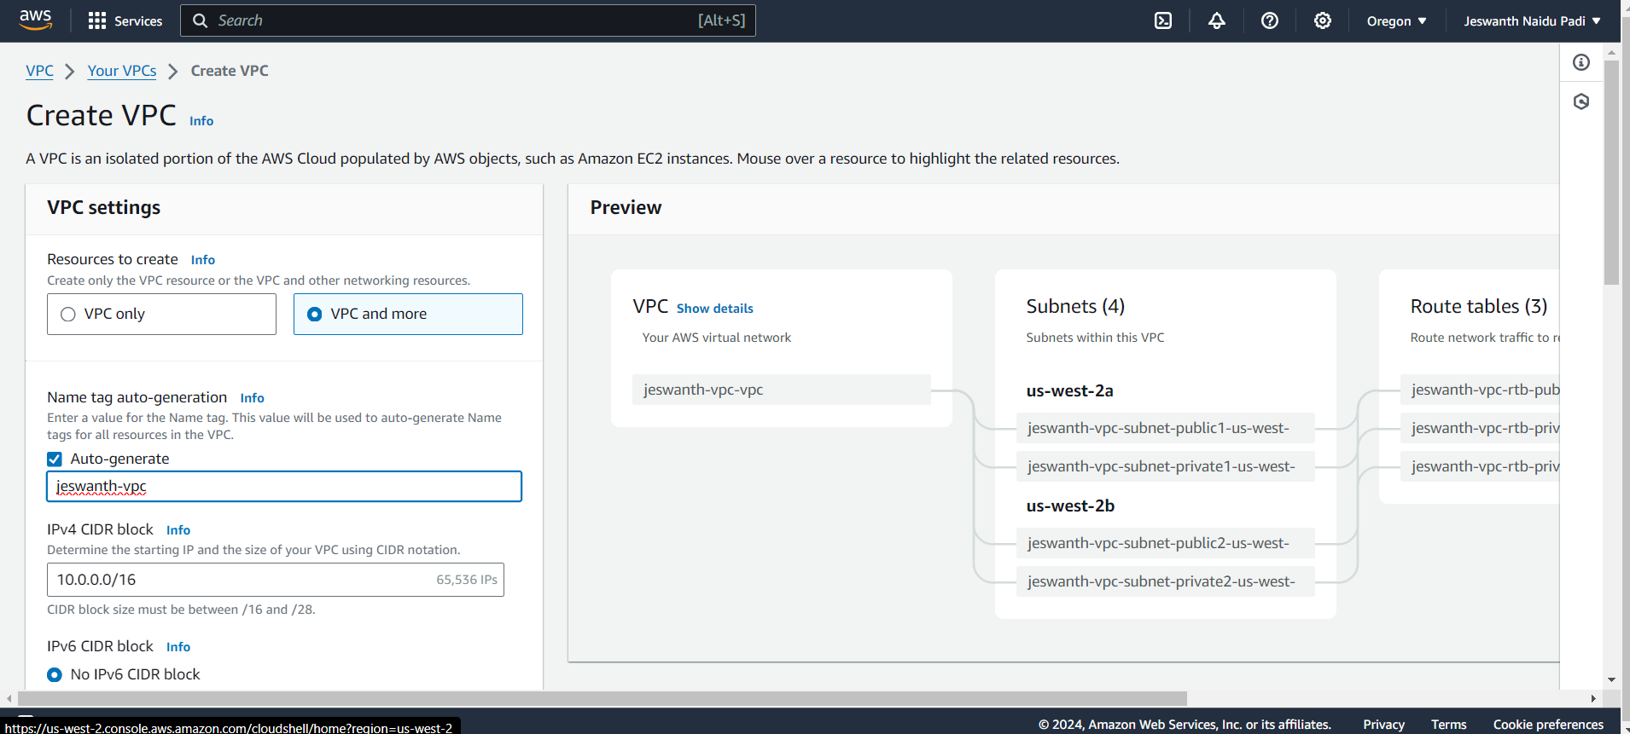
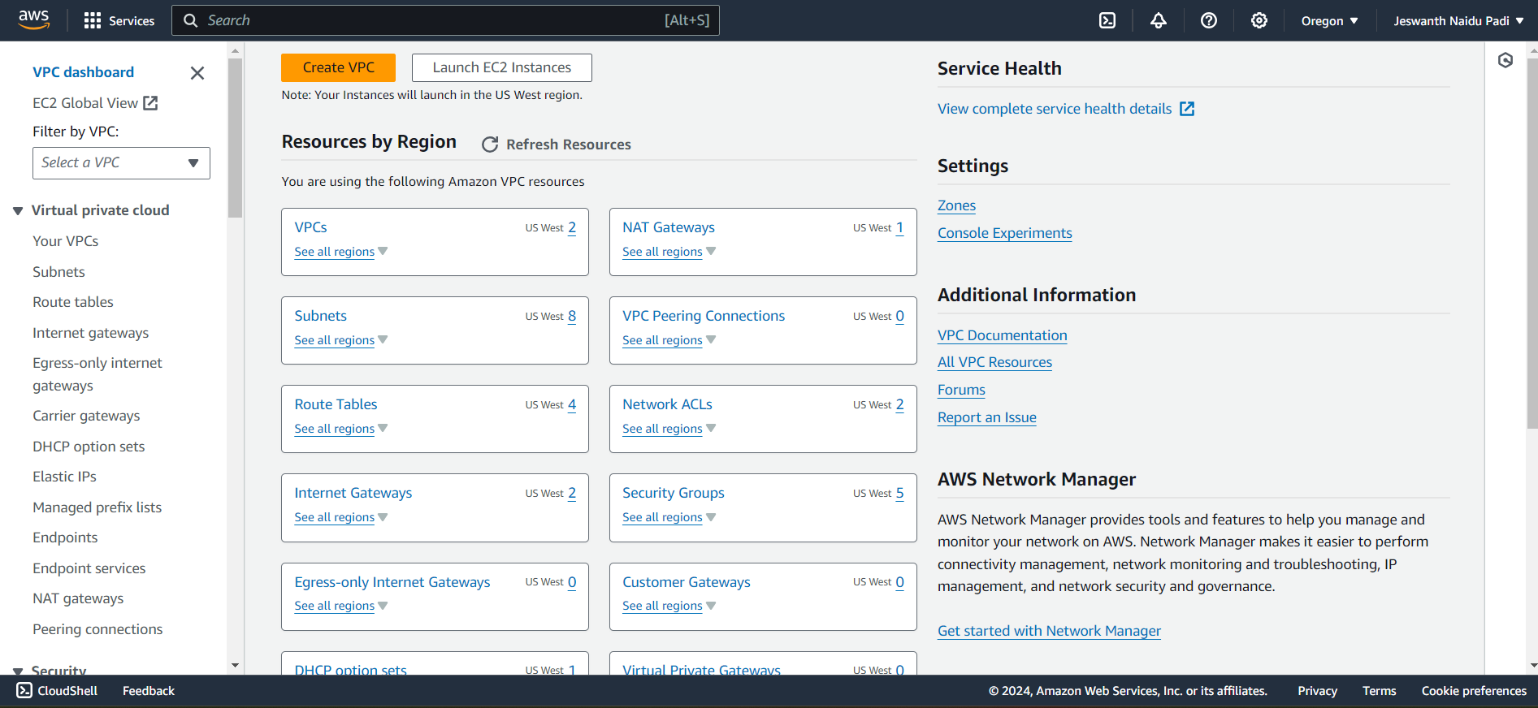
Creating Virtual Private Cloud (VPC):

Slide 8
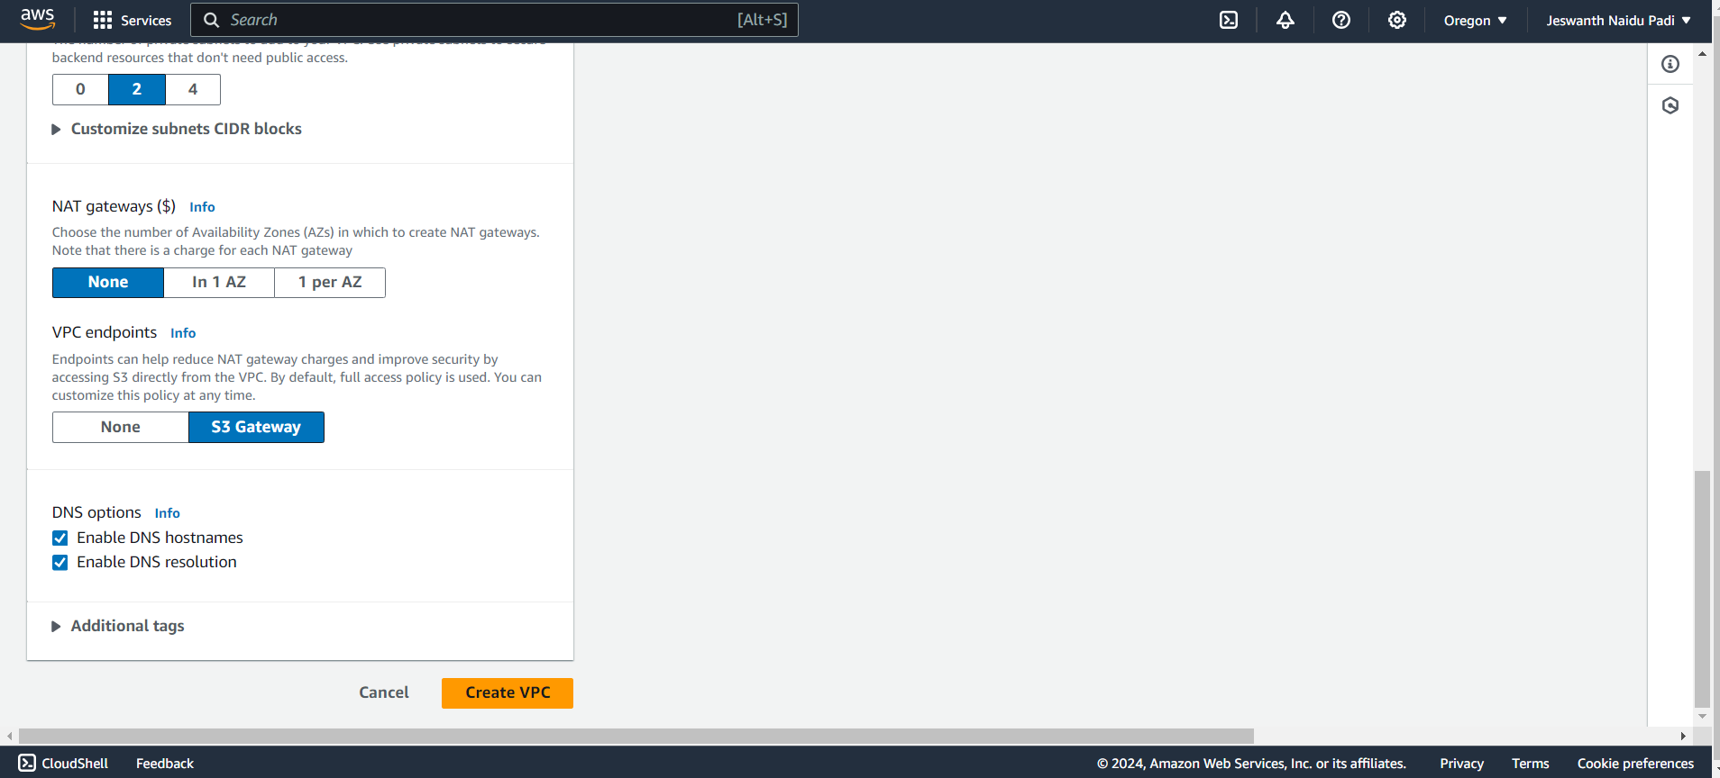
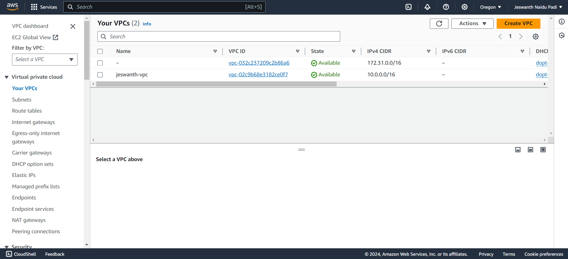

Slide 9
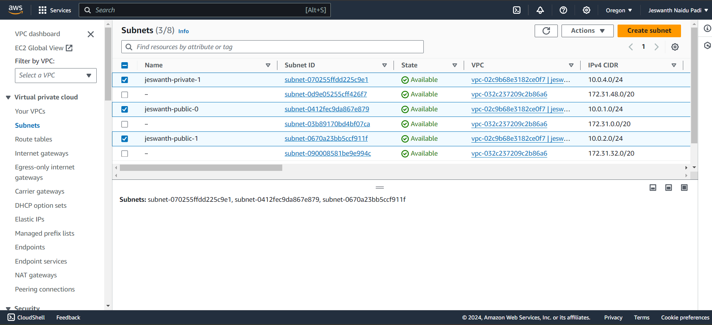
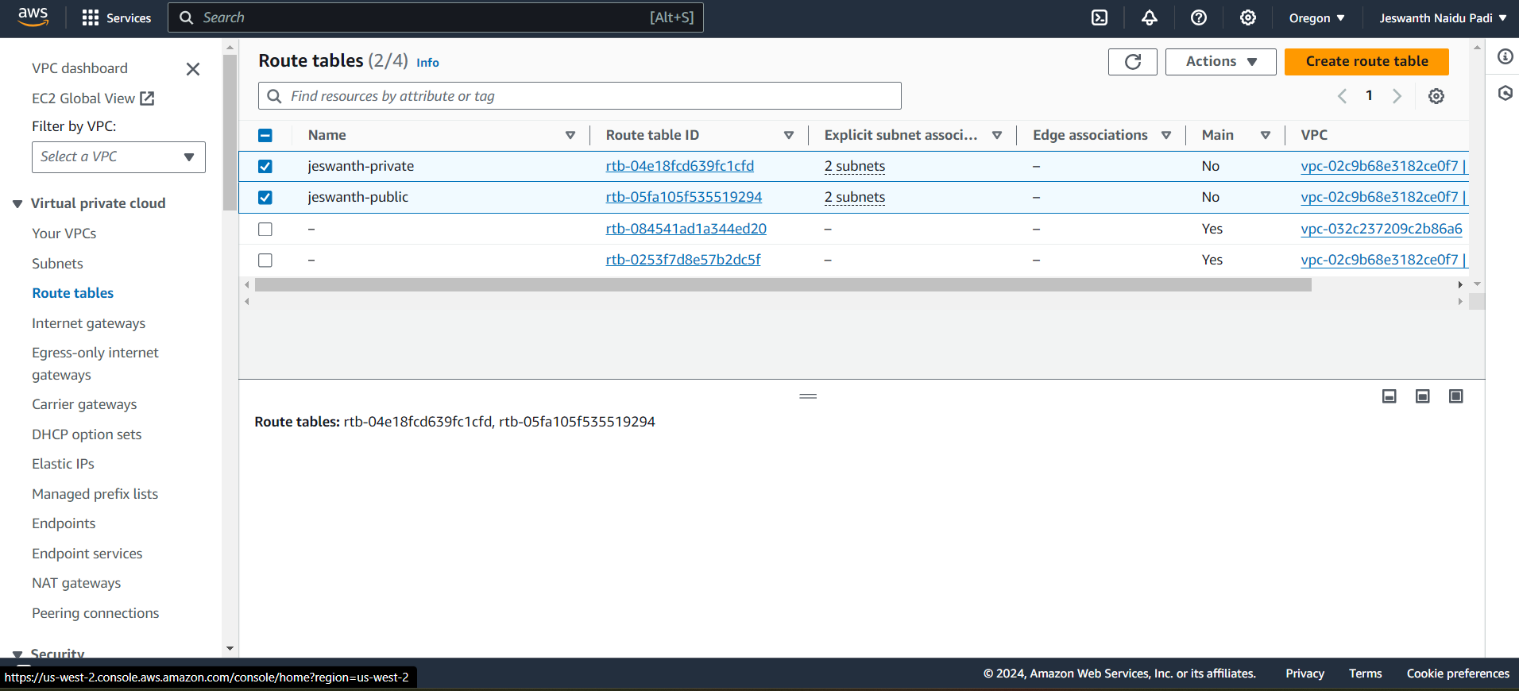
Created Subnets & Routetables:

Slide 10
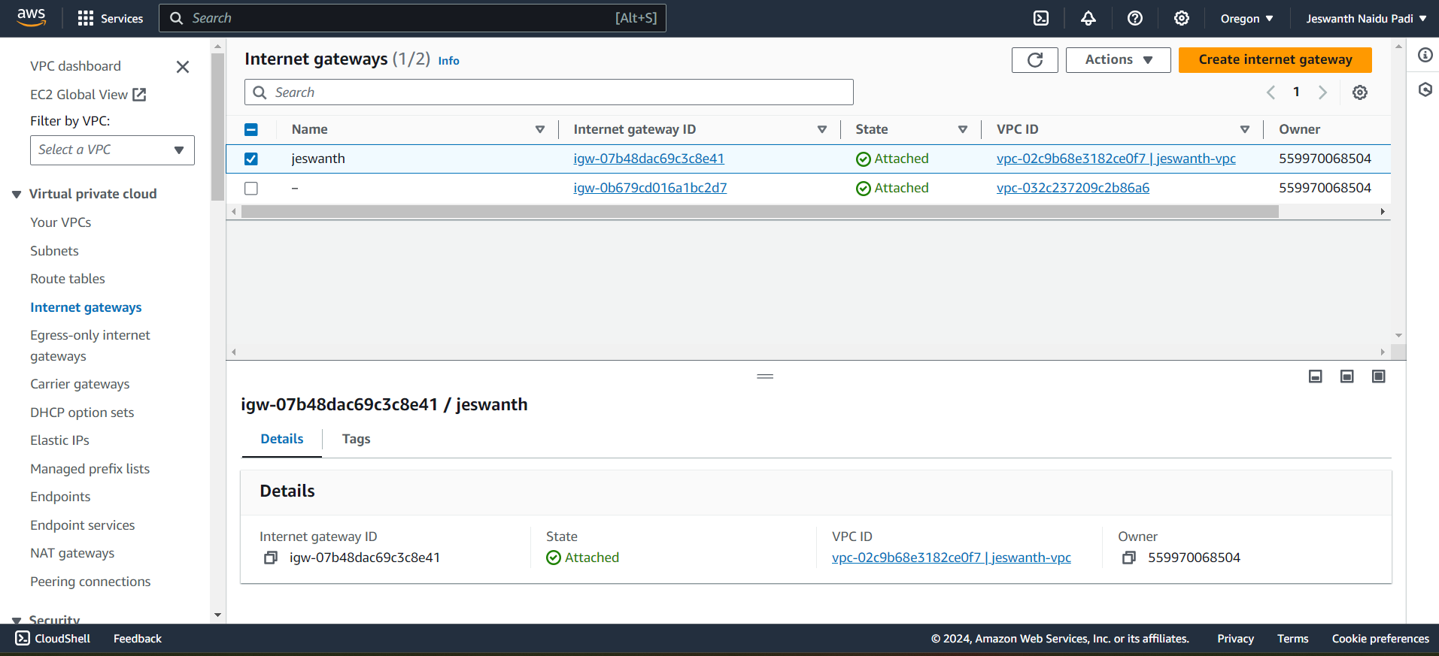
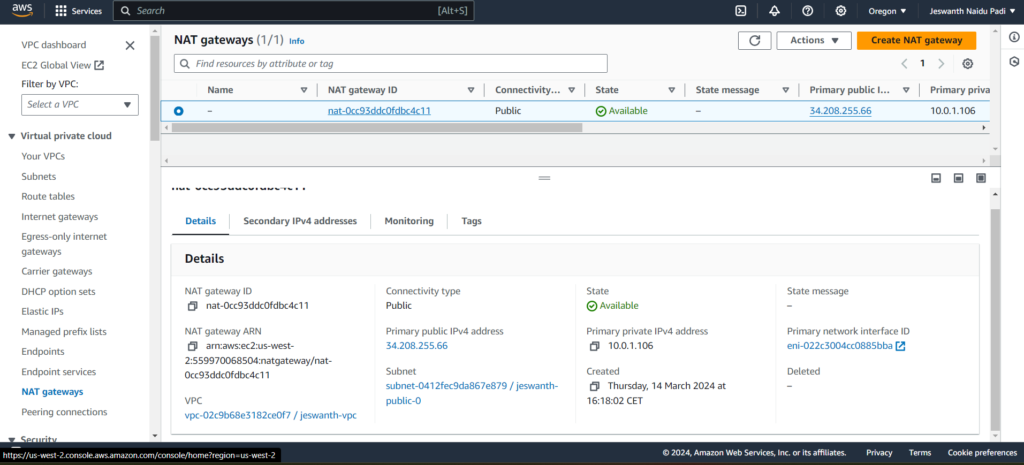
Created Internet & NAT Gateways:

Slide 11
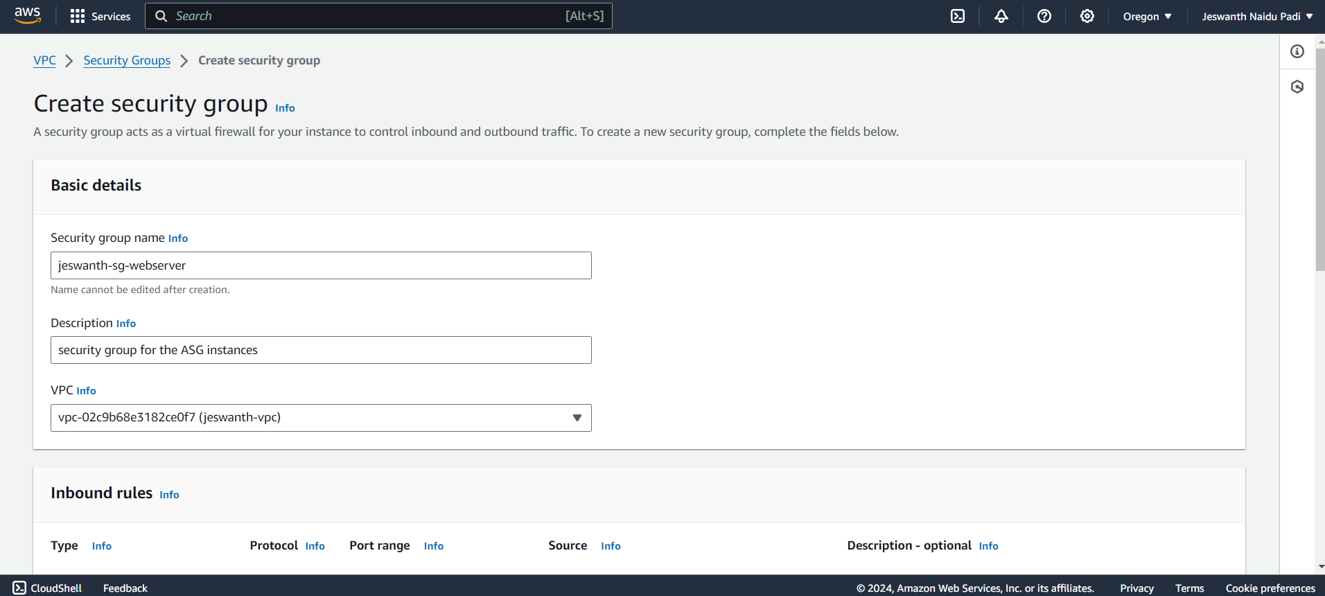
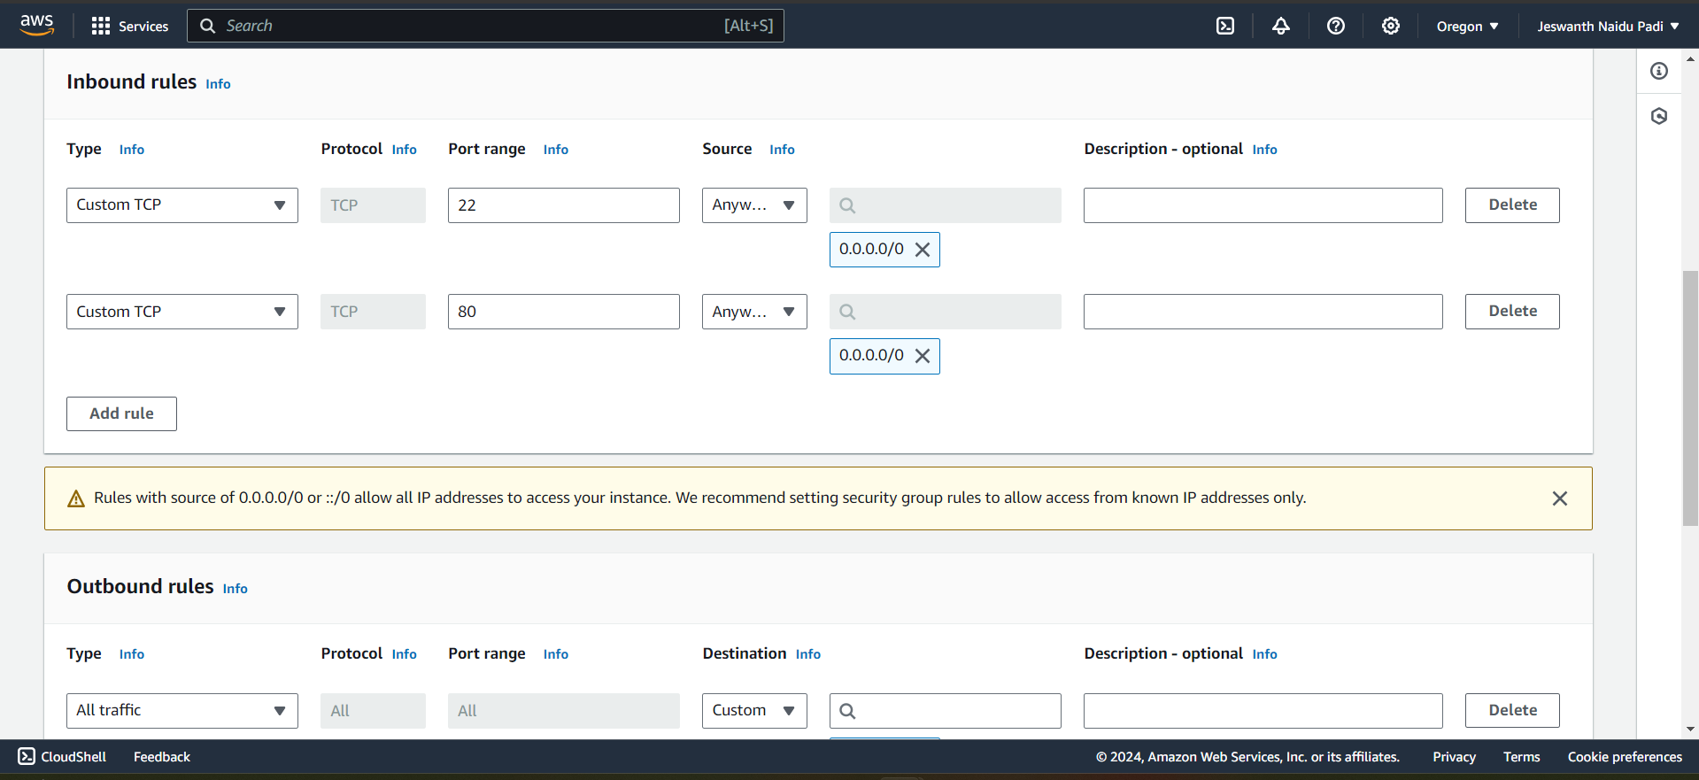
Creating Security Groups for Web server:

Slide 12
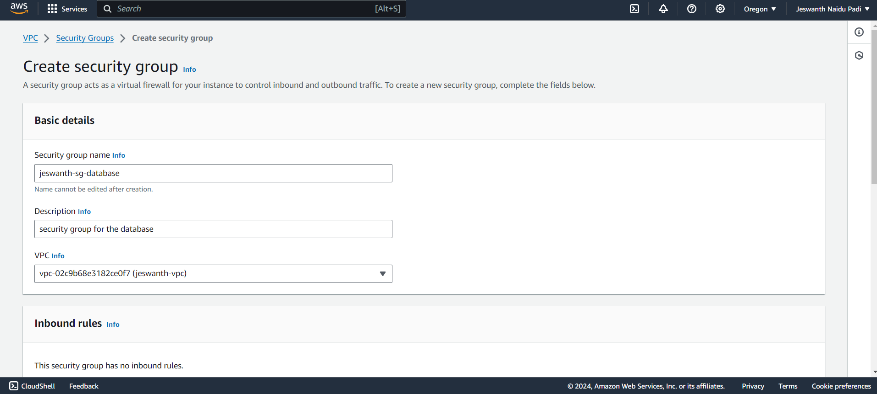
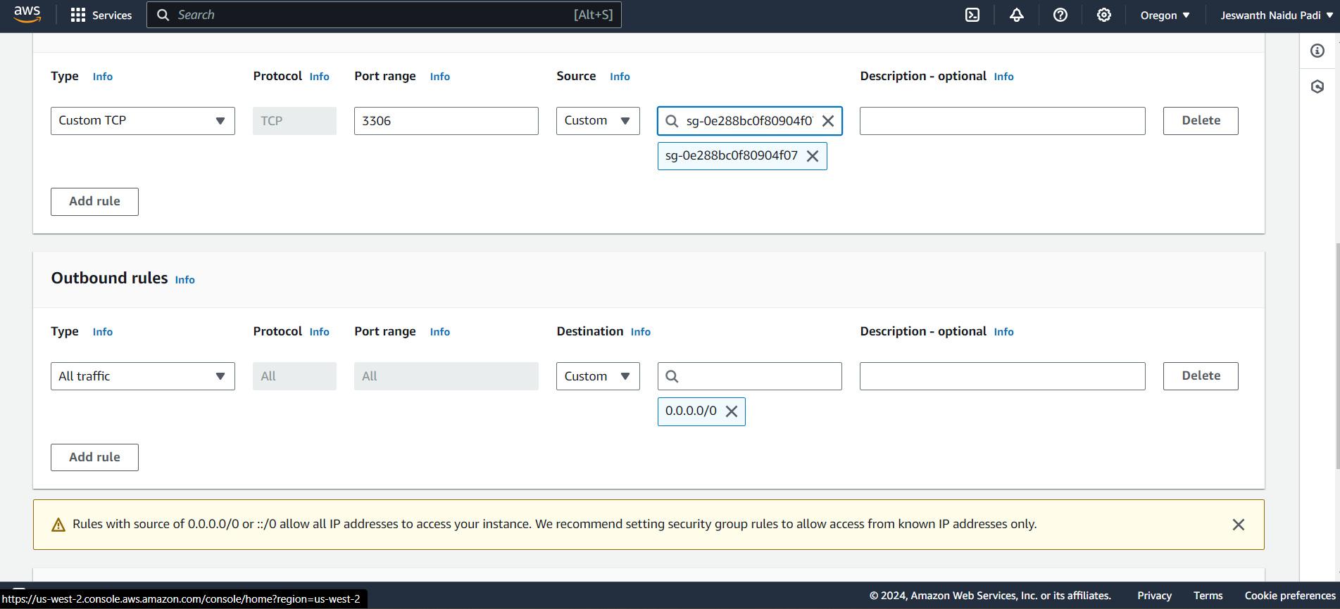
Creating Security Groups for database:

Slide 13
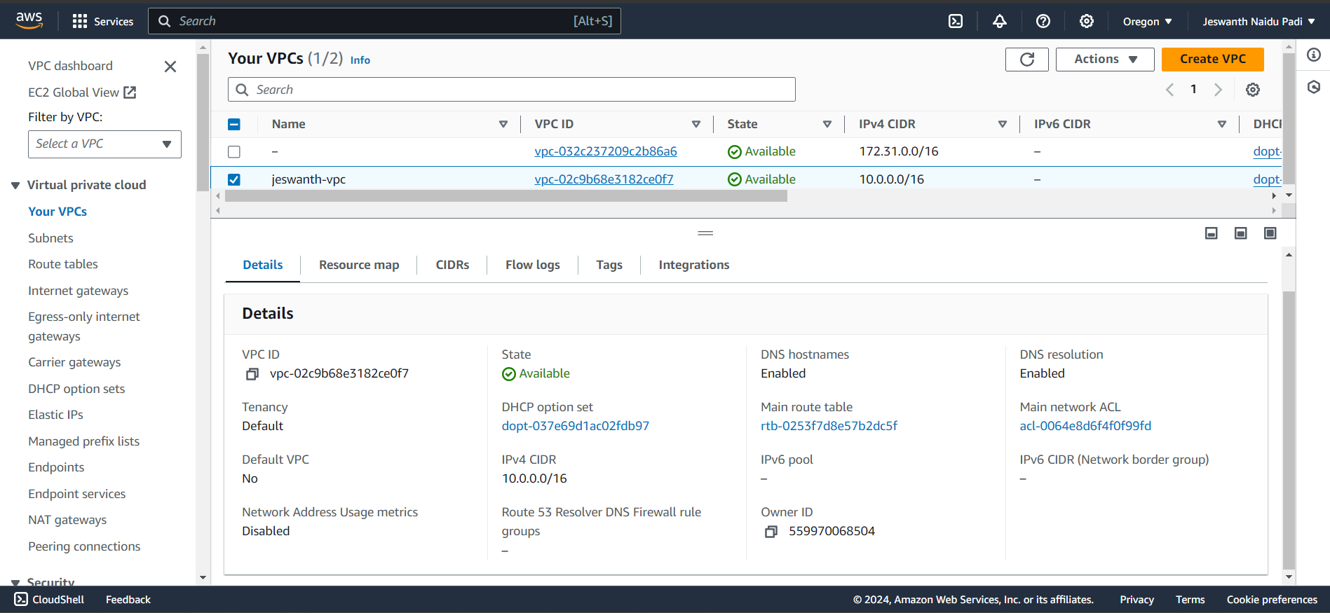
These security groups will provide access to MariaDB
Till here we have completed creating prerequisites, networking and security part.

Slide 14
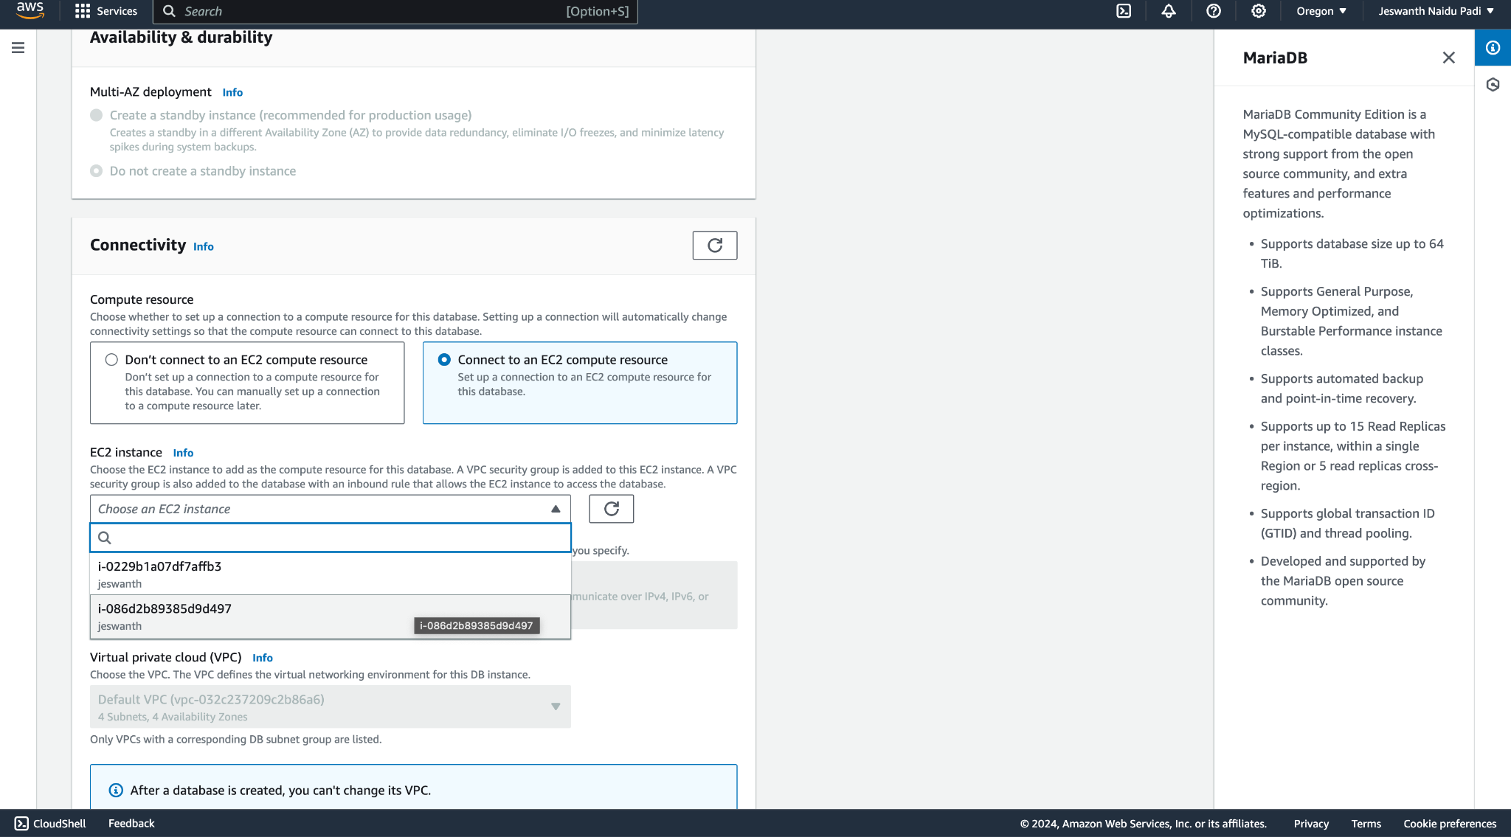
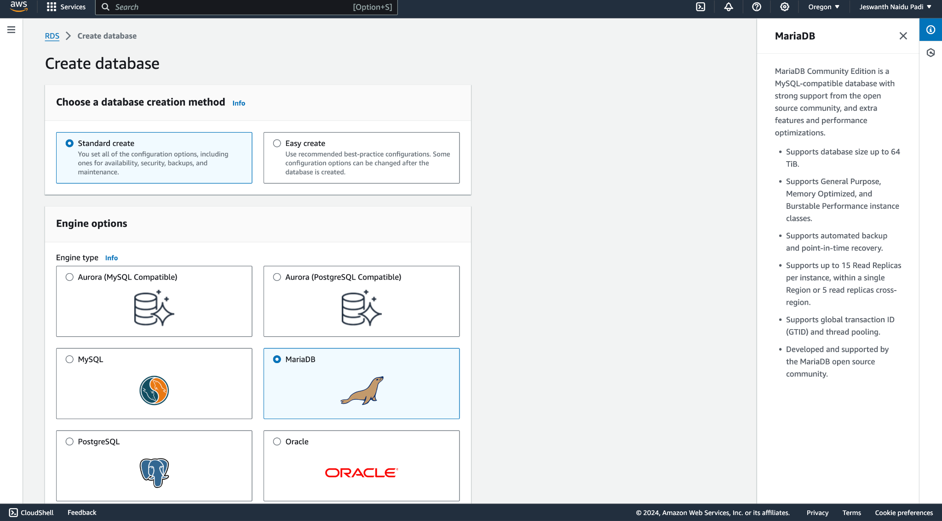
Creating database:

Slide 15
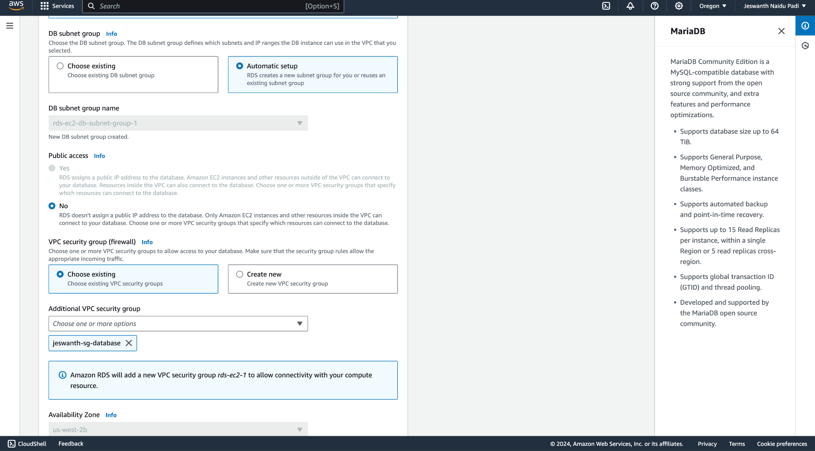
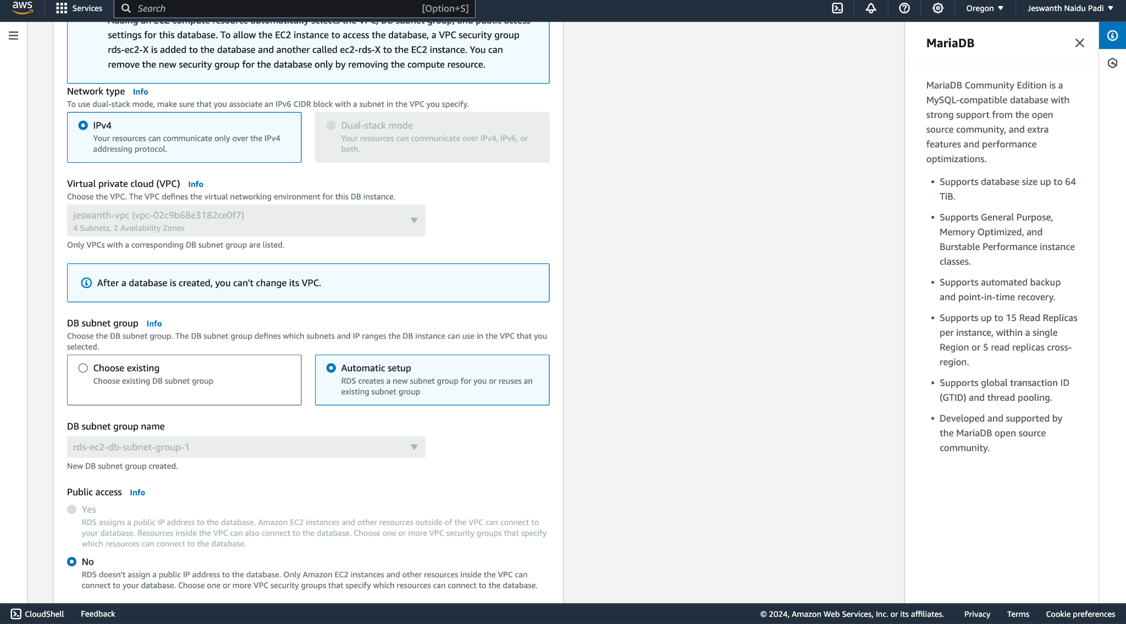
Selecting database engine and parameter group

Slide 16
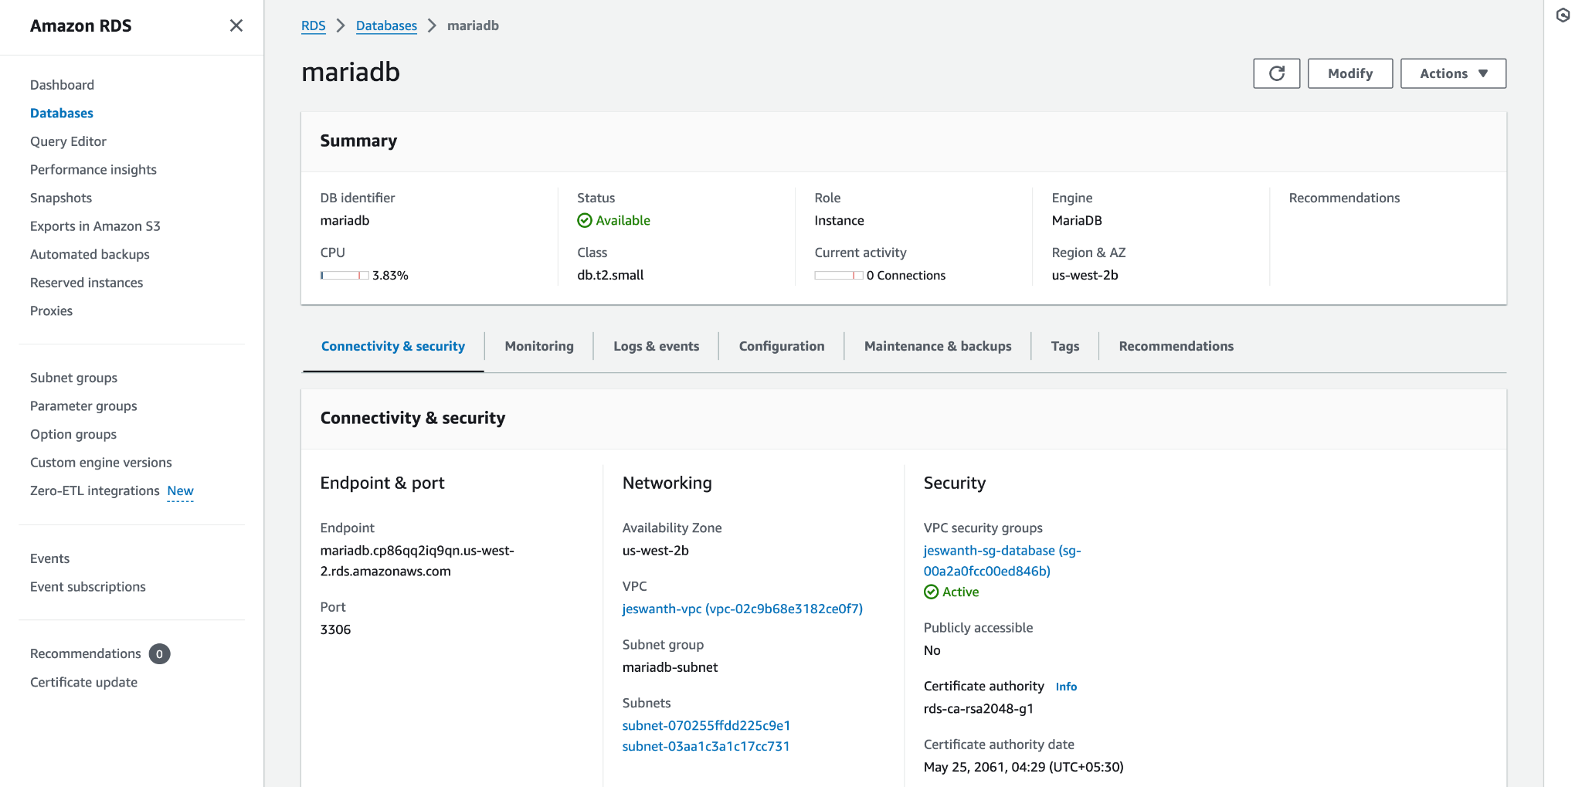
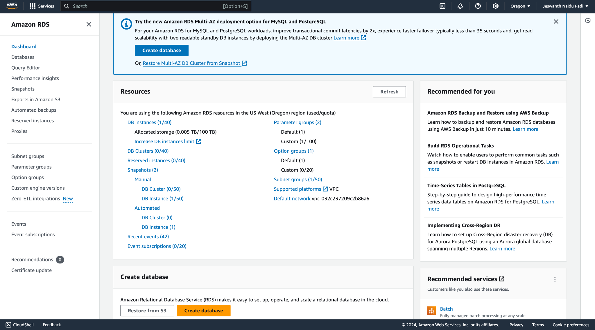
Database Deployment :

Slide 17
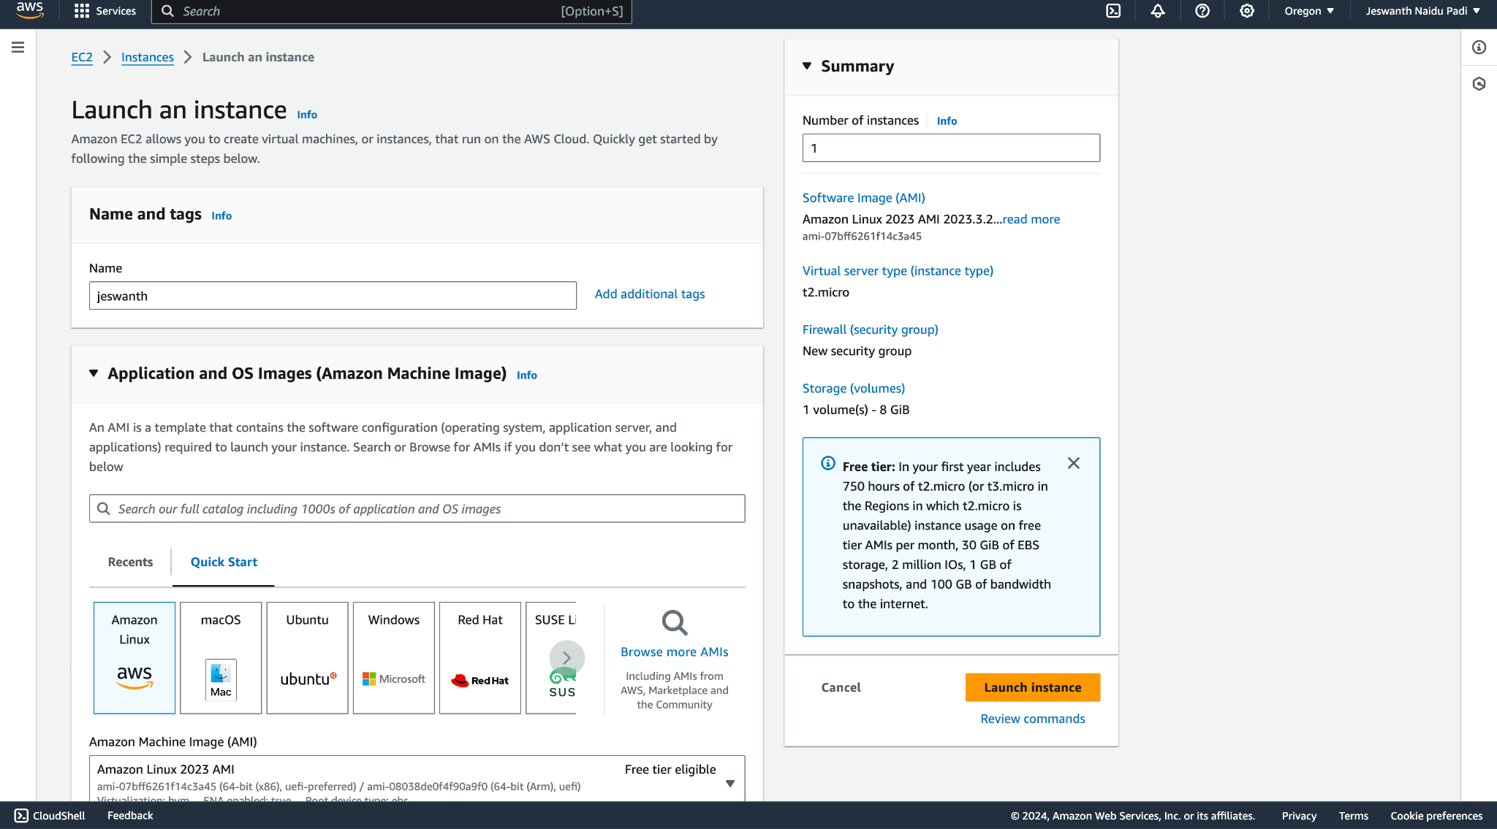
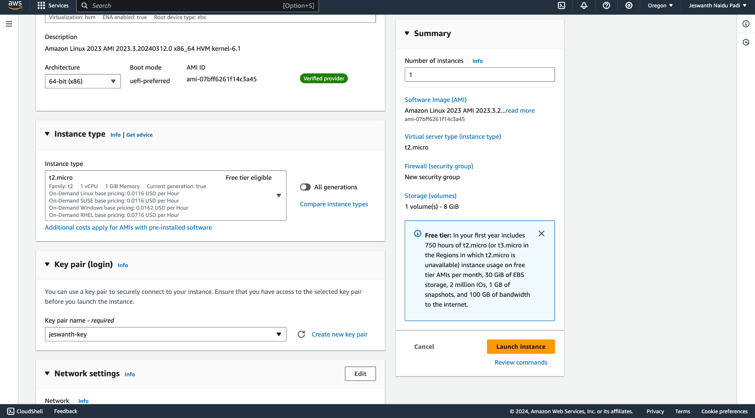
Creating EC2 instance:

Slide 18
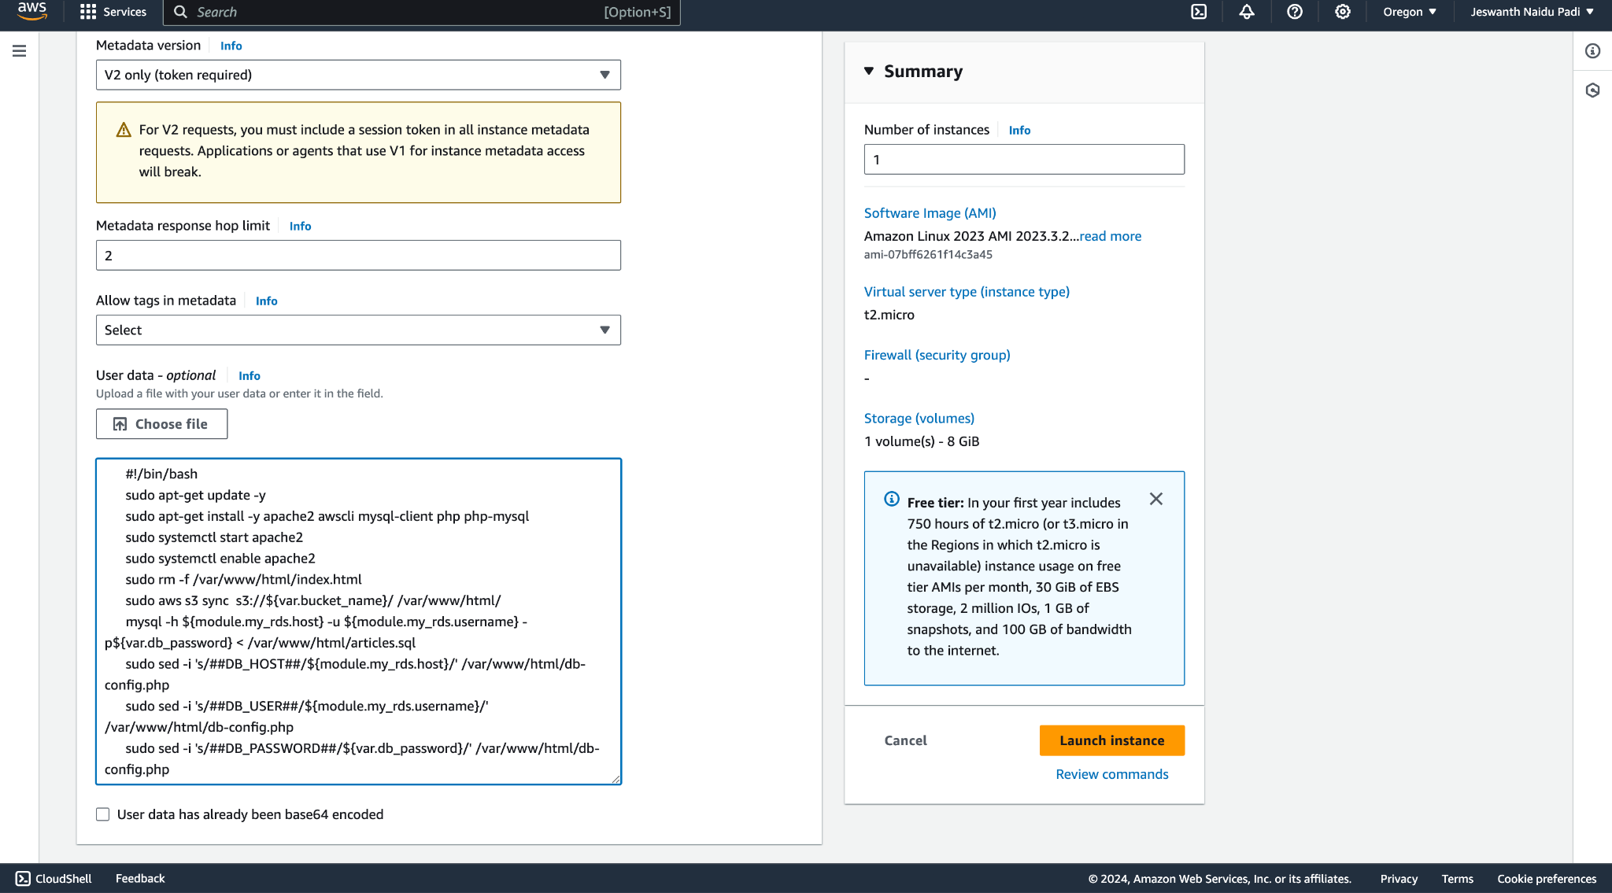
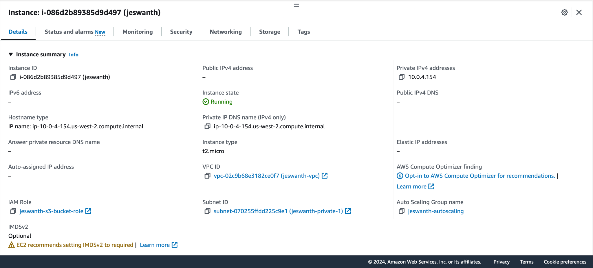
Adding Git project as user_data to the EC2 instance:

Slide 19
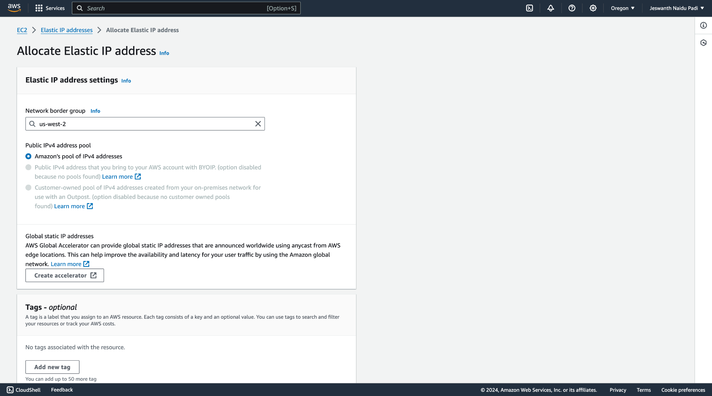
Creating an Elastic IP address:

Slide 20
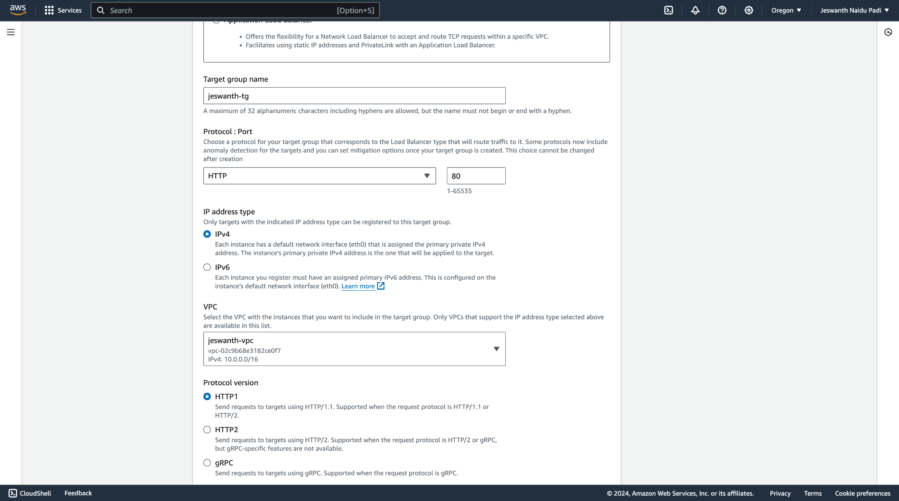
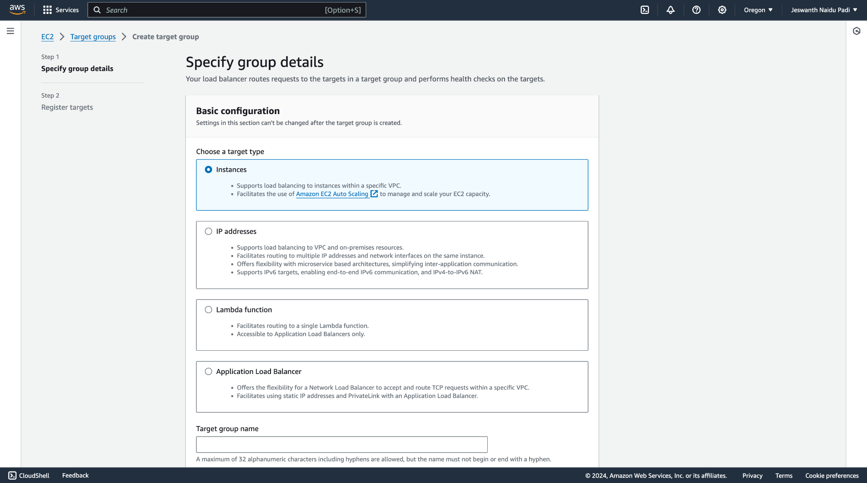
Creating Target Groups for EC2 instance:

Slide 21
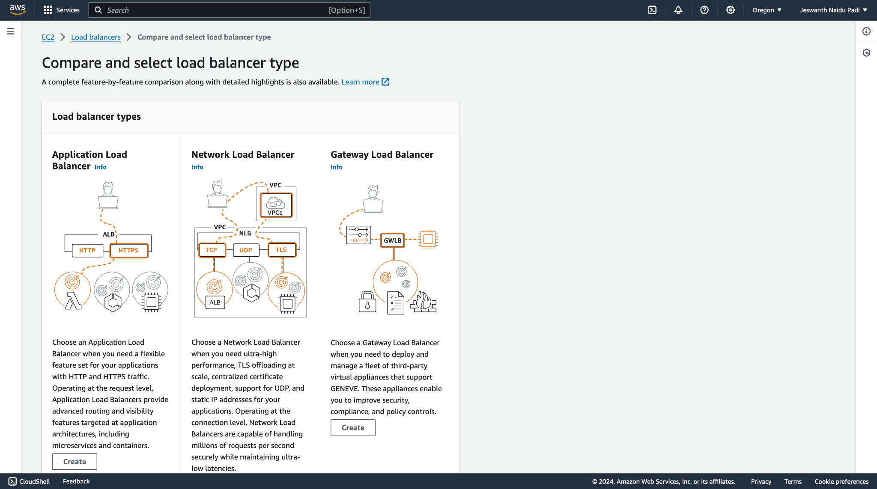
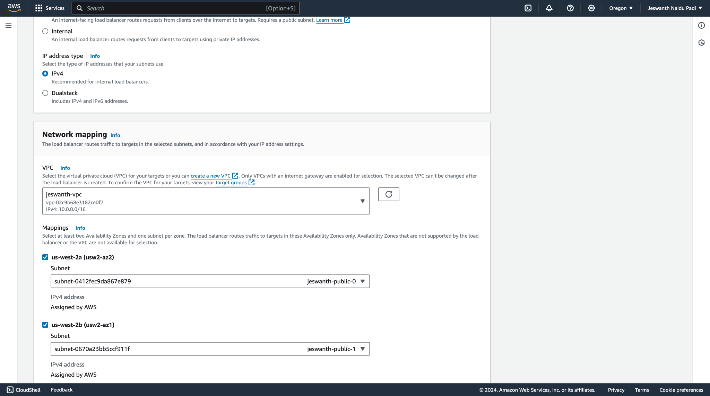
Creating Load Balancer for EC2 instance:

Slide 22
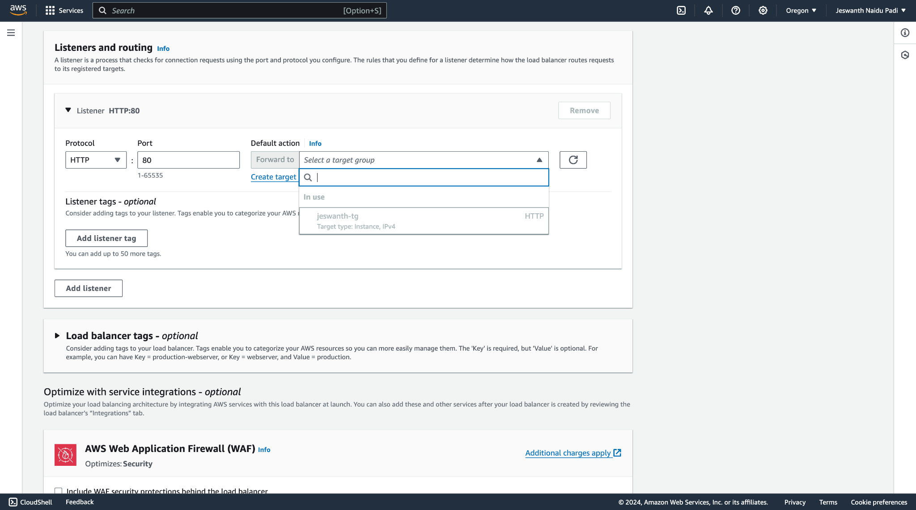
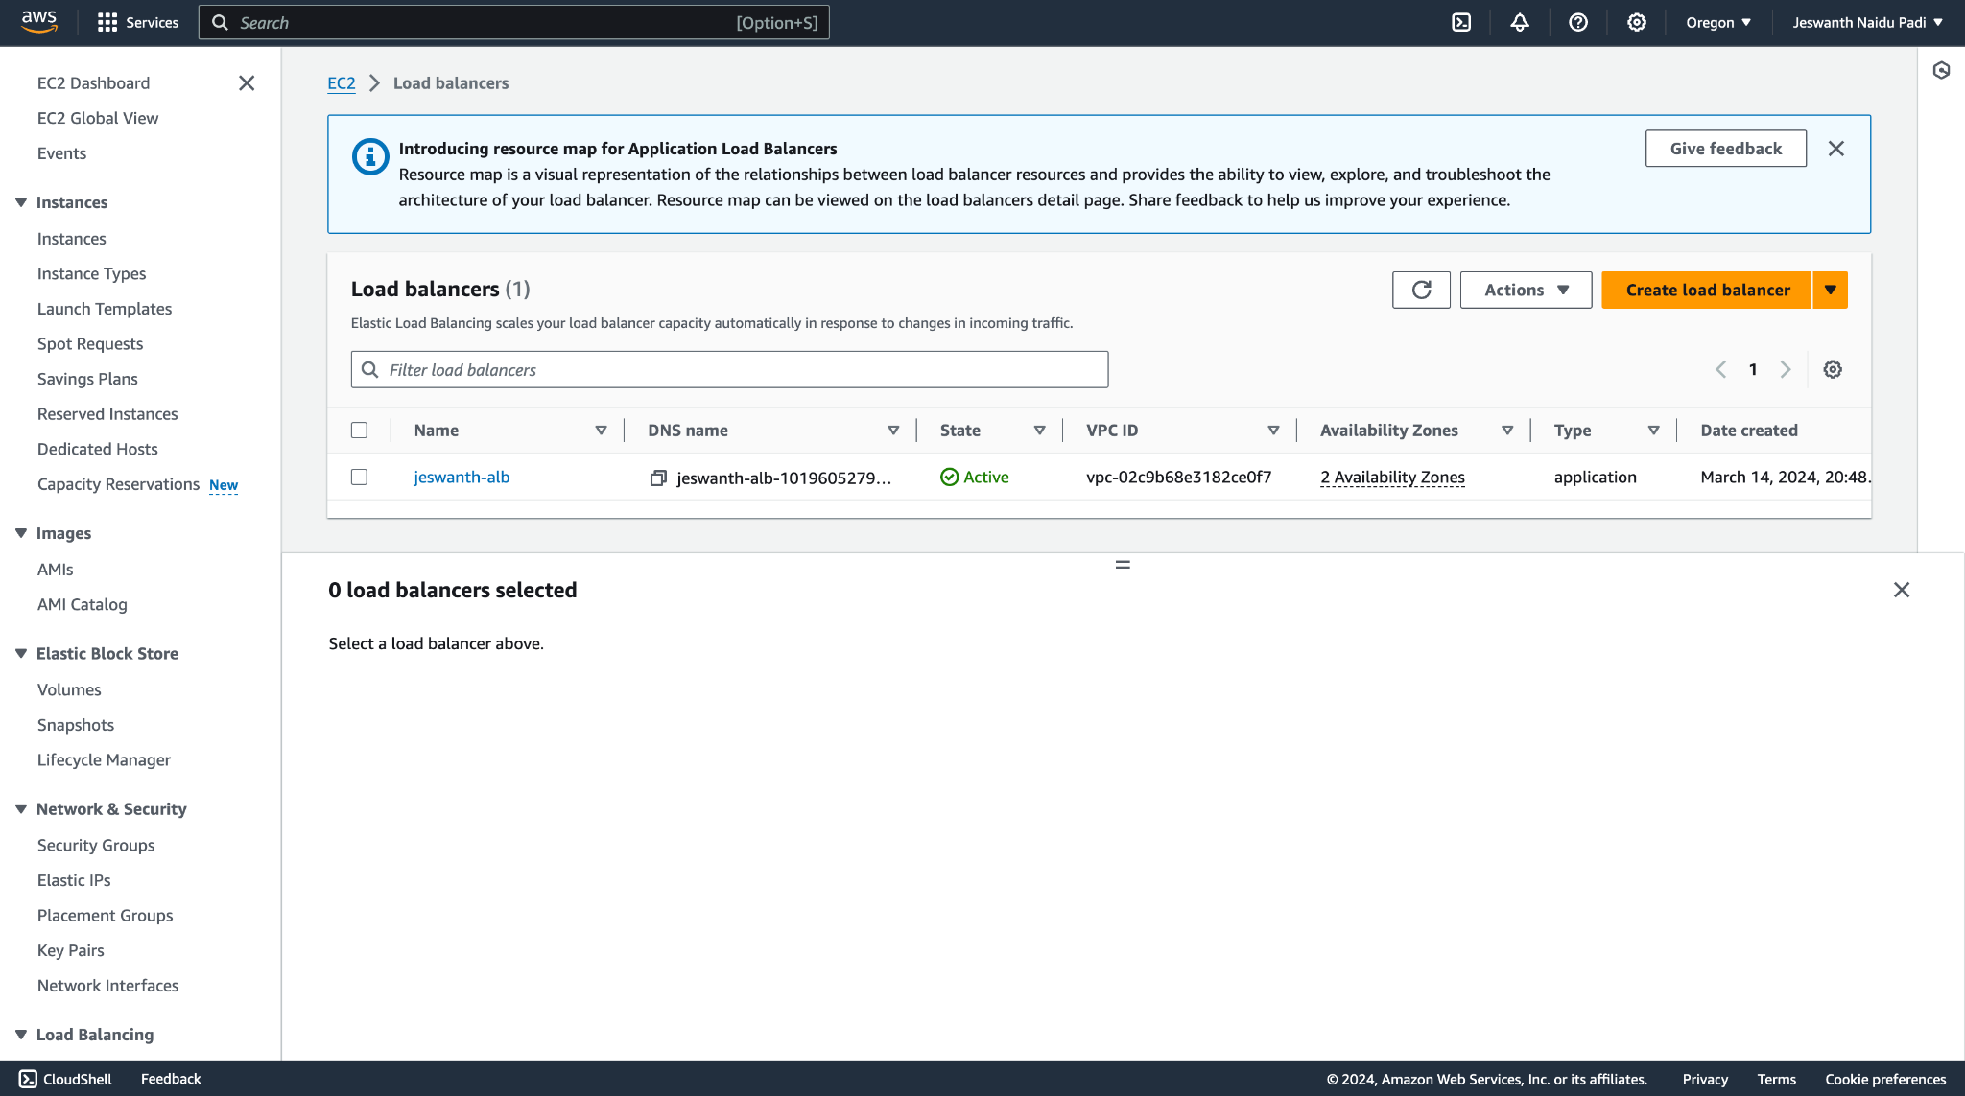
Attaching the ALB to the EC2 instance:

Slide 23
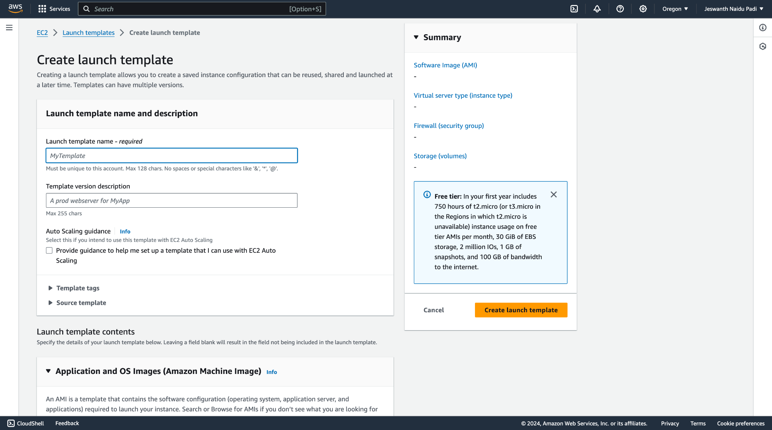
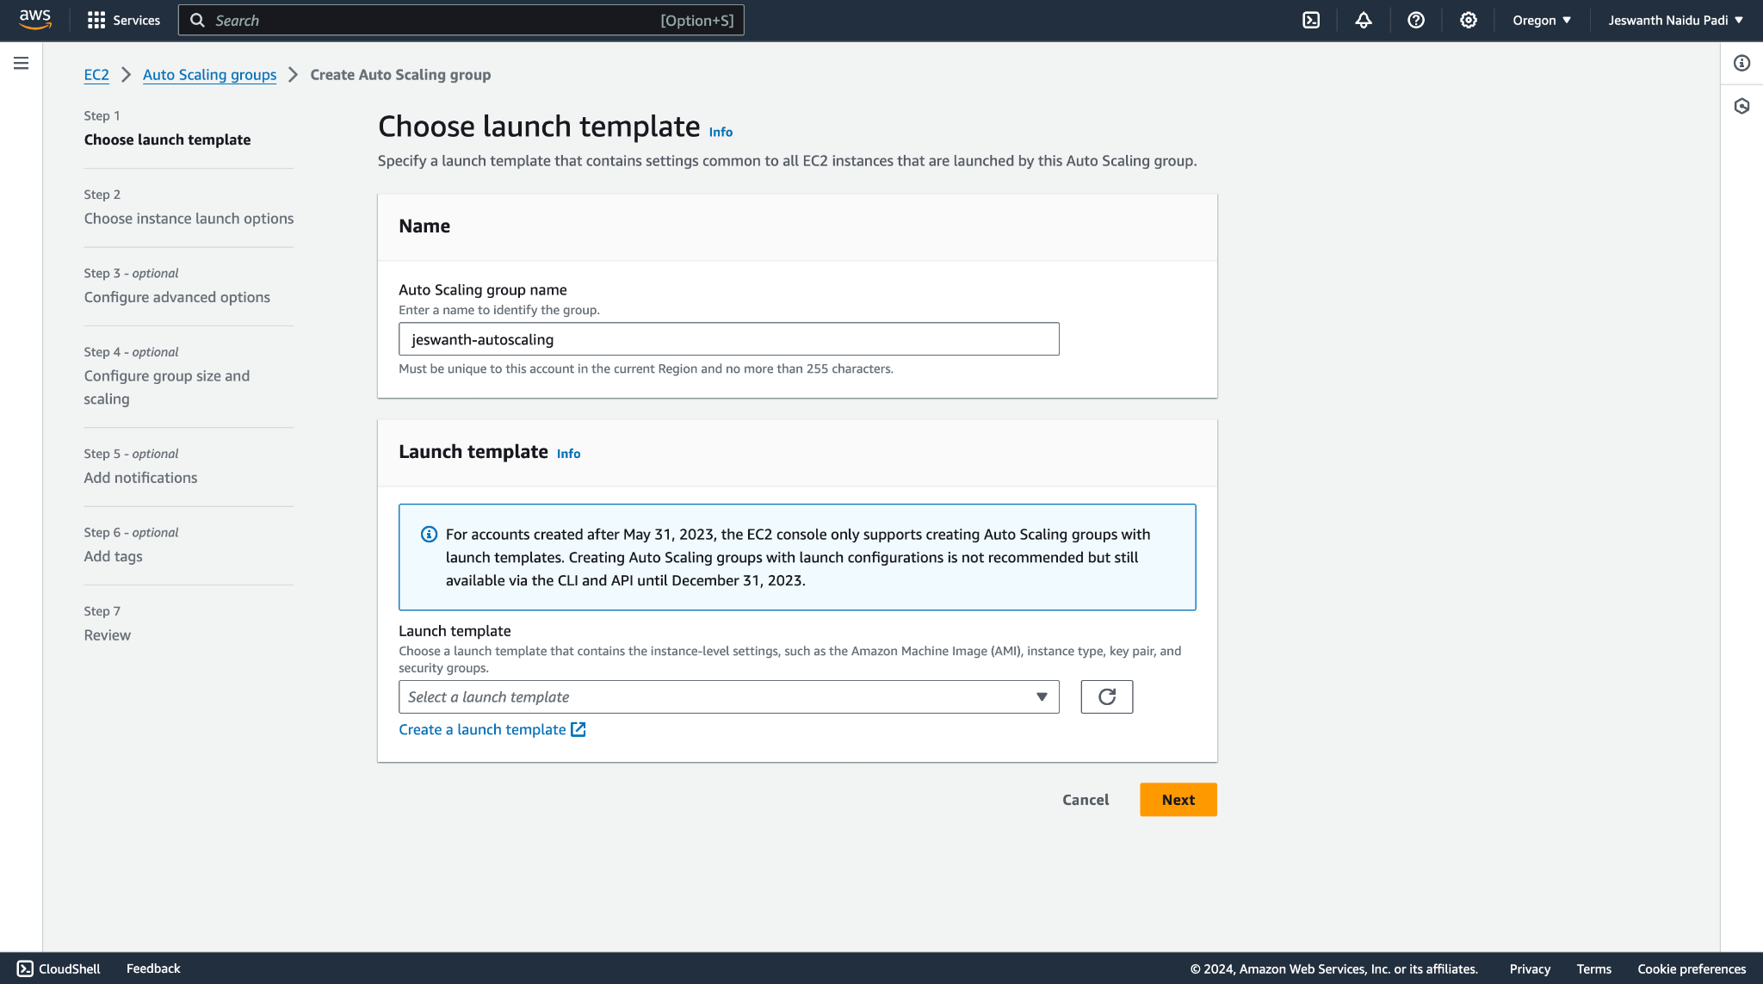
Creating the launch template for EC2 instance:

Slide 24
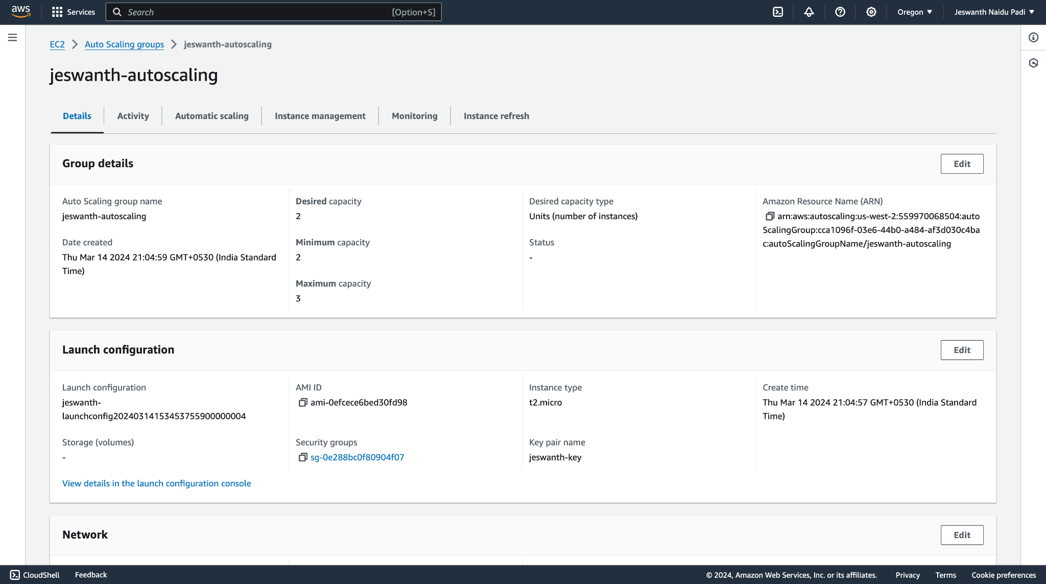
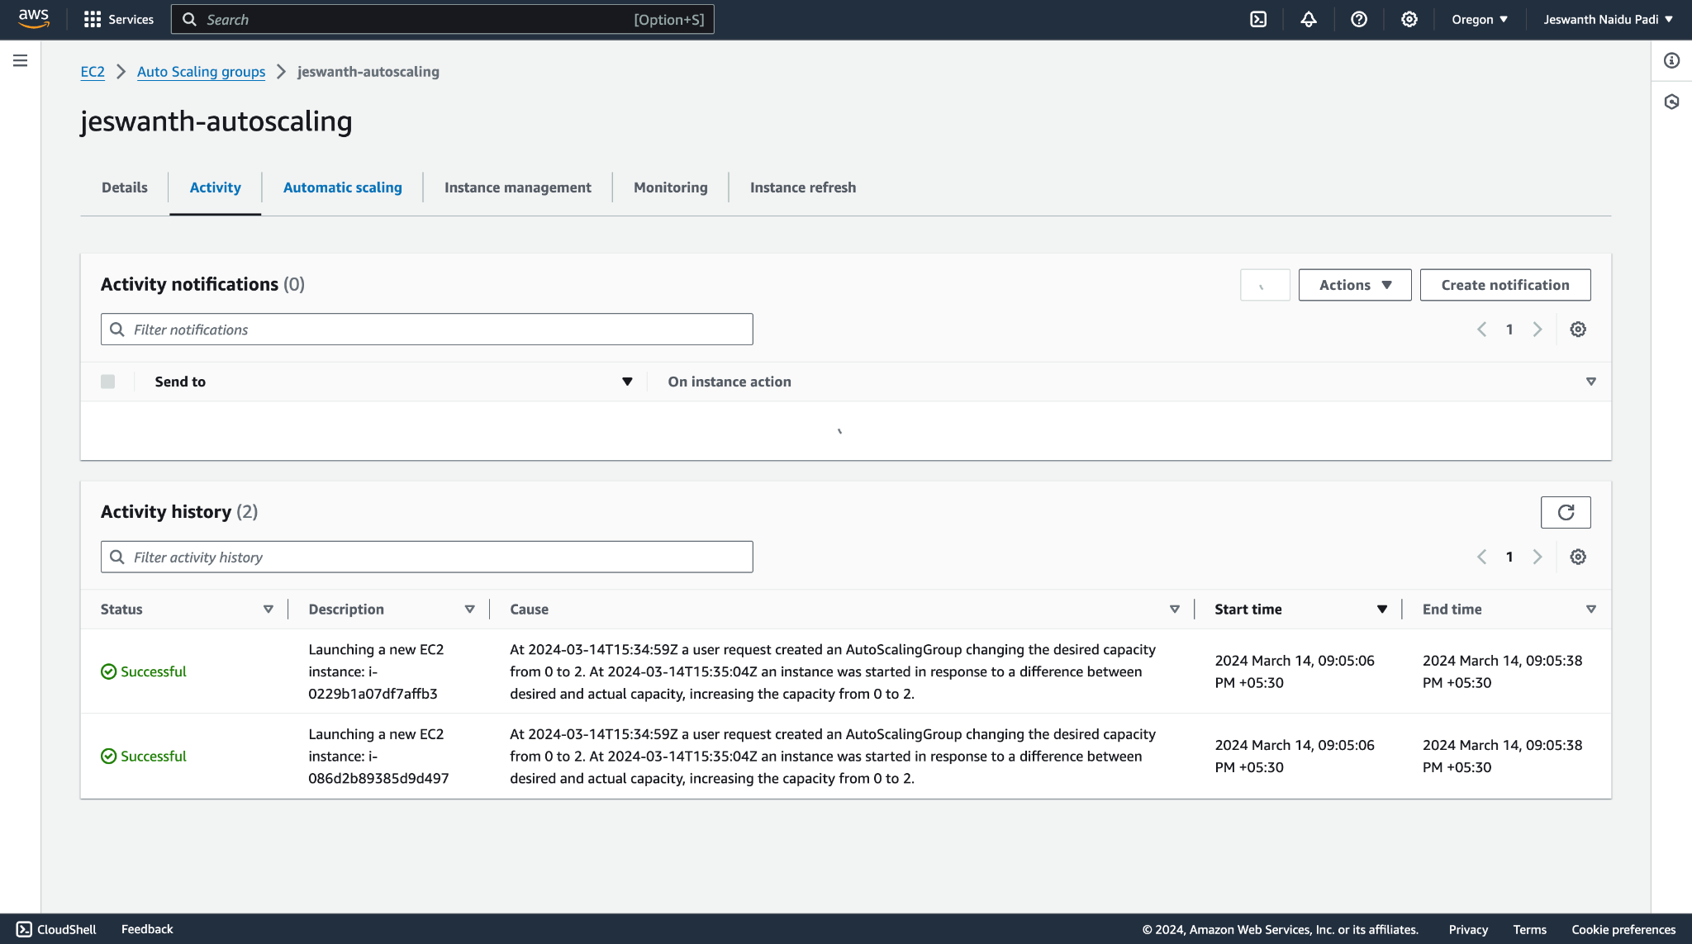
Creating Auto-Scaling Group:

Slide 25
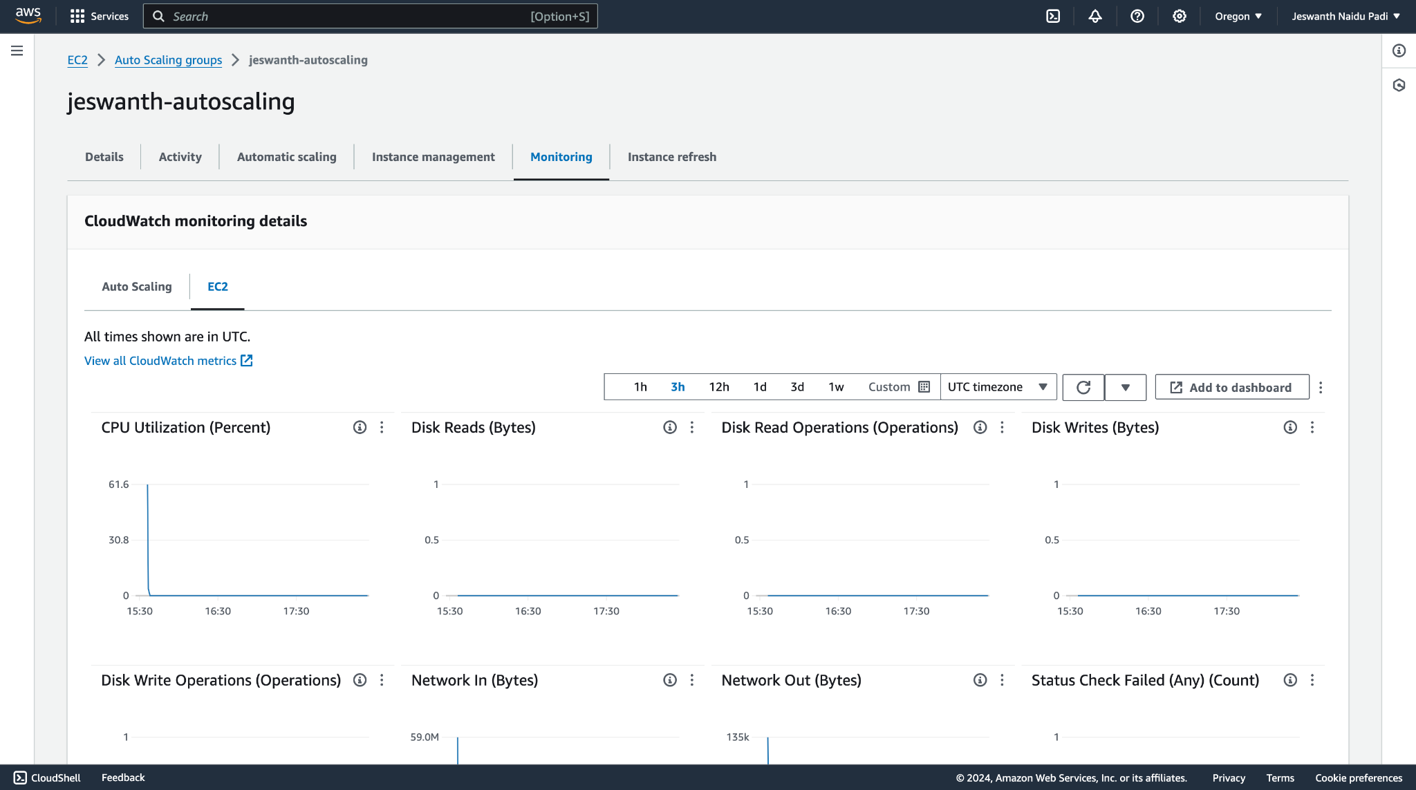
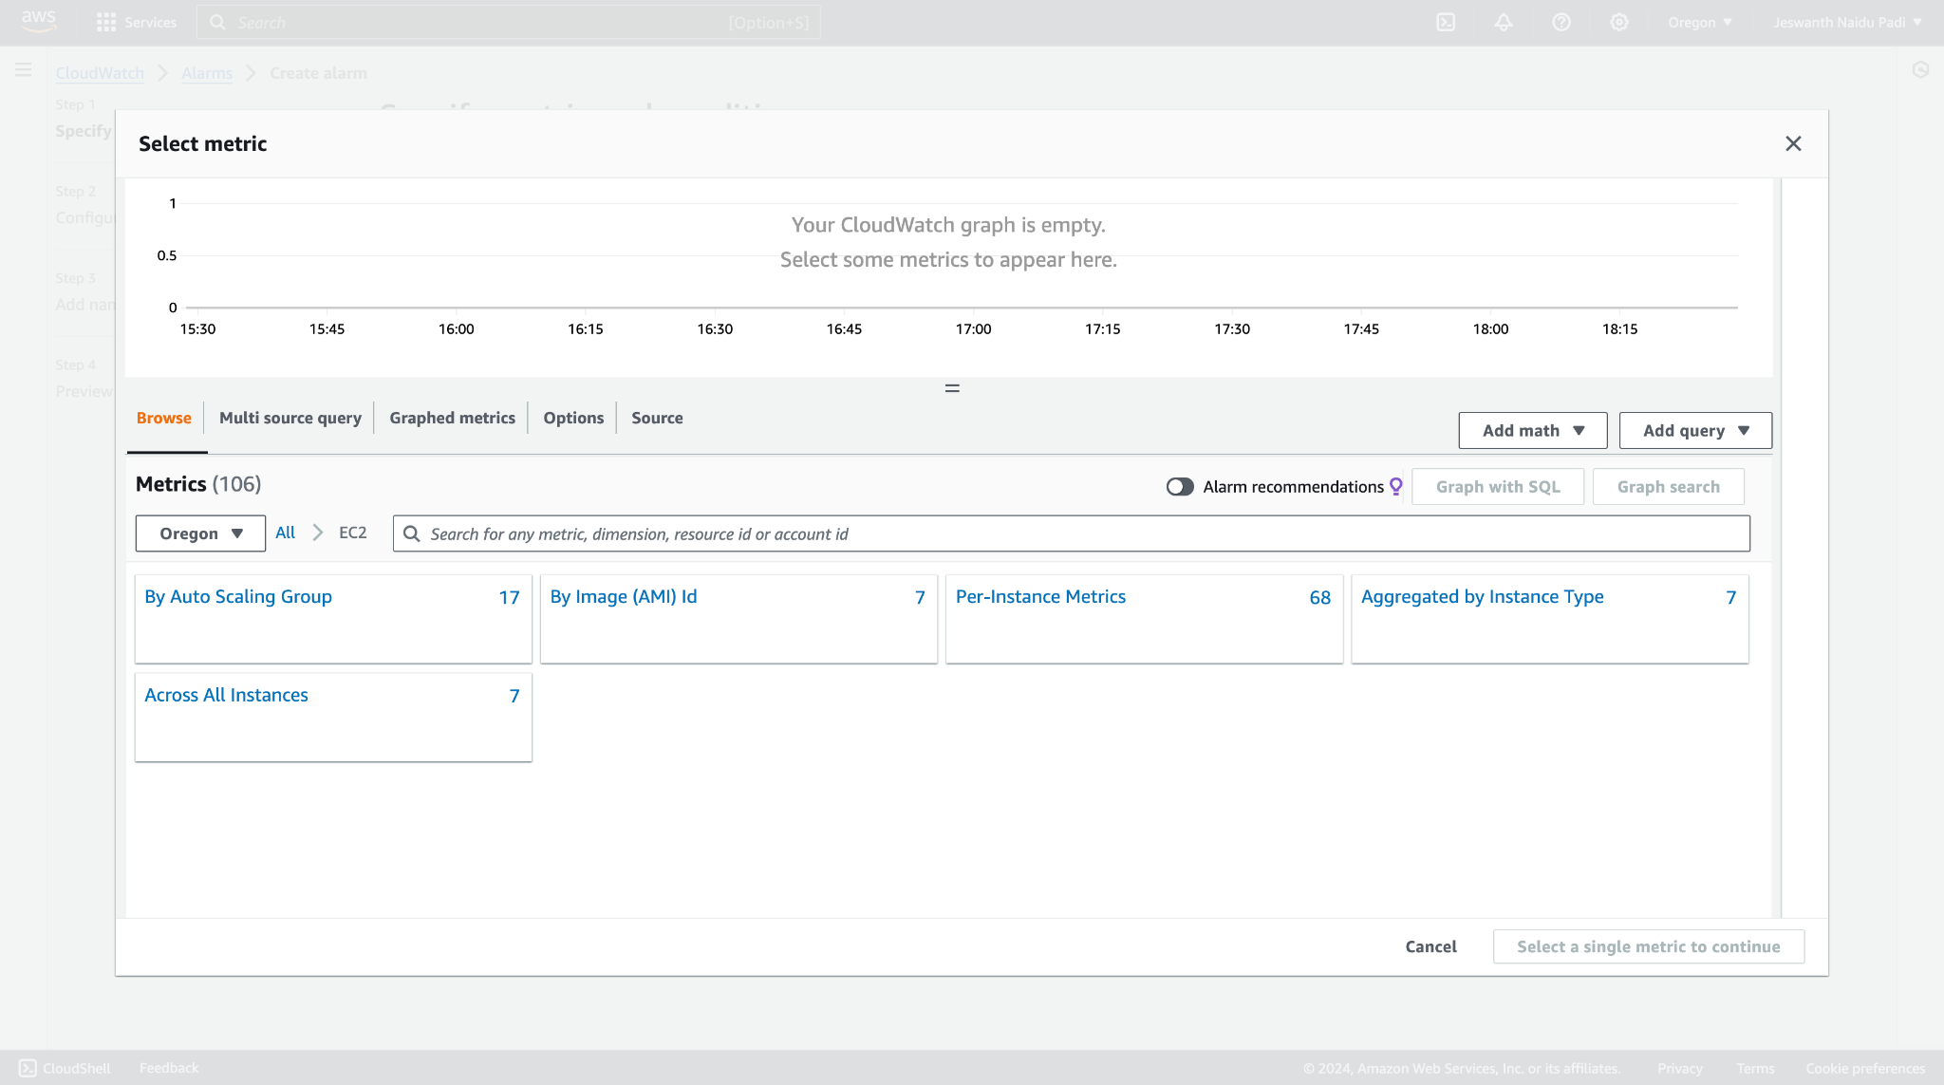
Graphs before stress test:

Slide 26
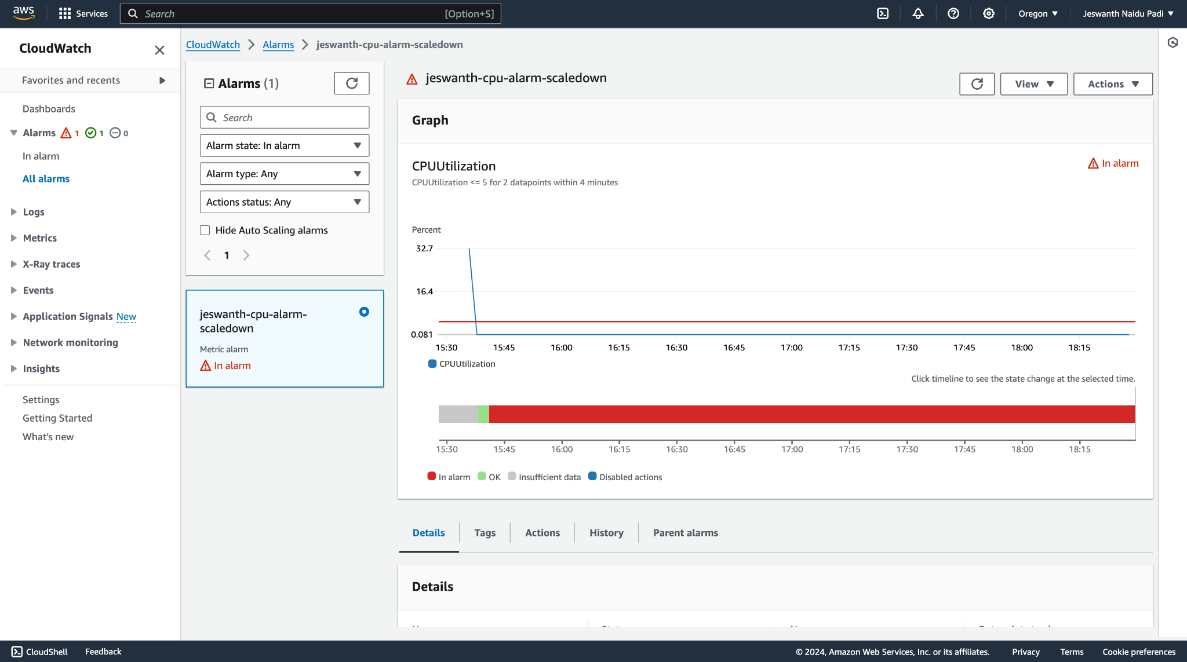
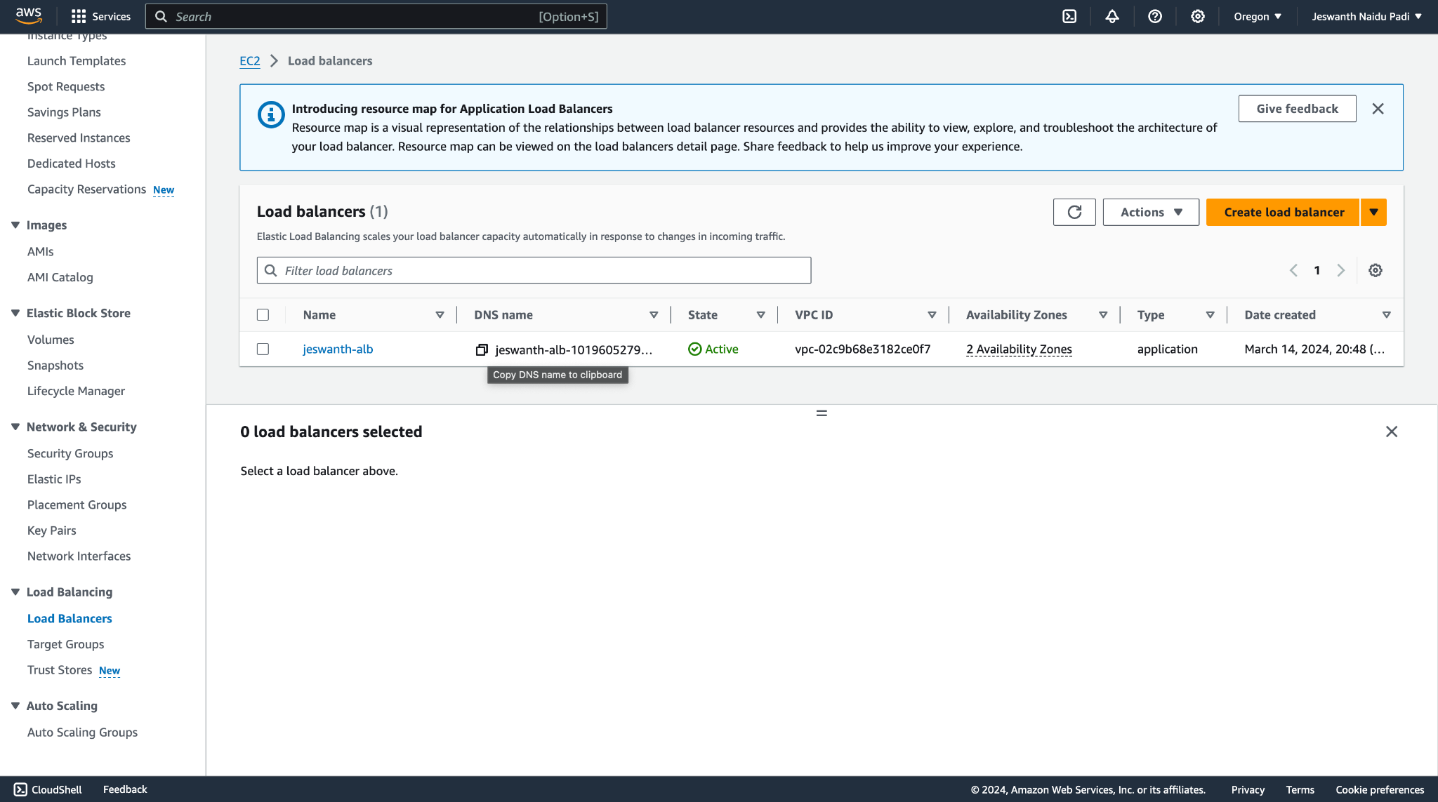
Monitoring stats of the EC2 instance before the stress test:

Slide 27
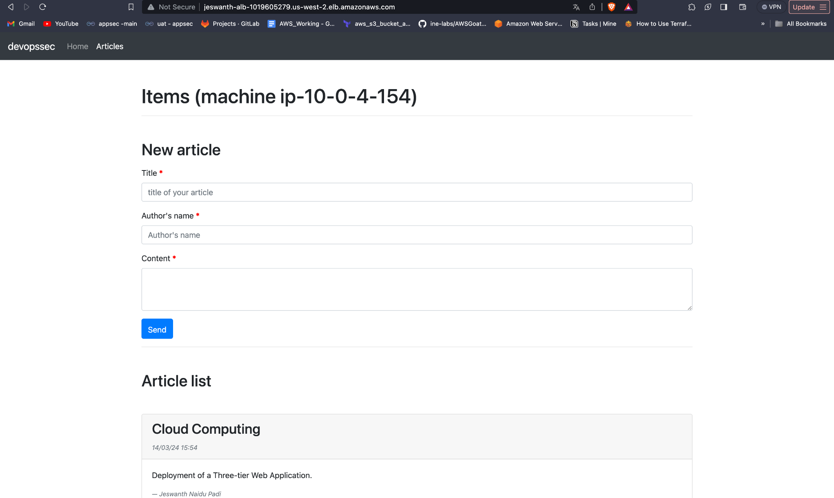
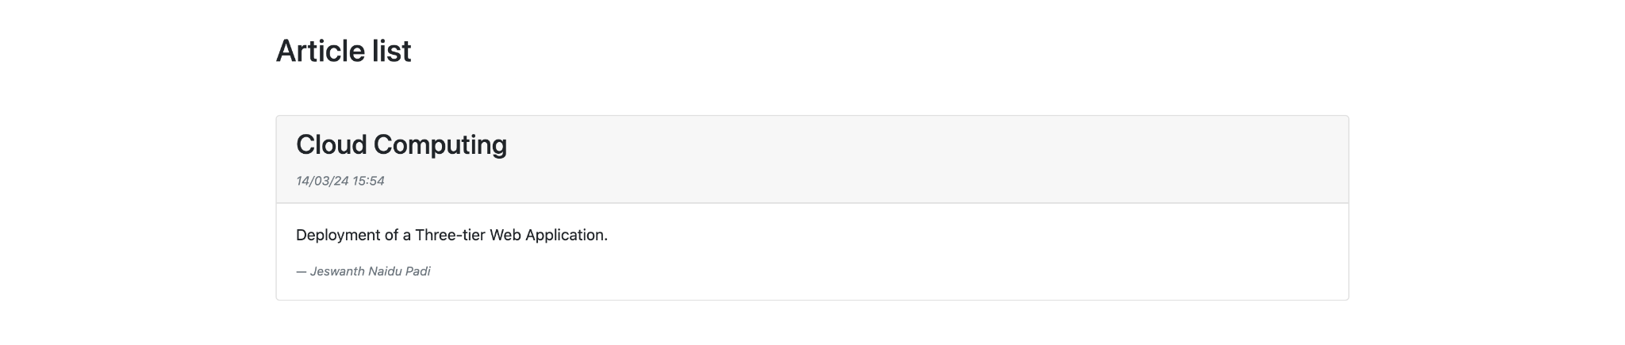
Web application preview:

Slide 28
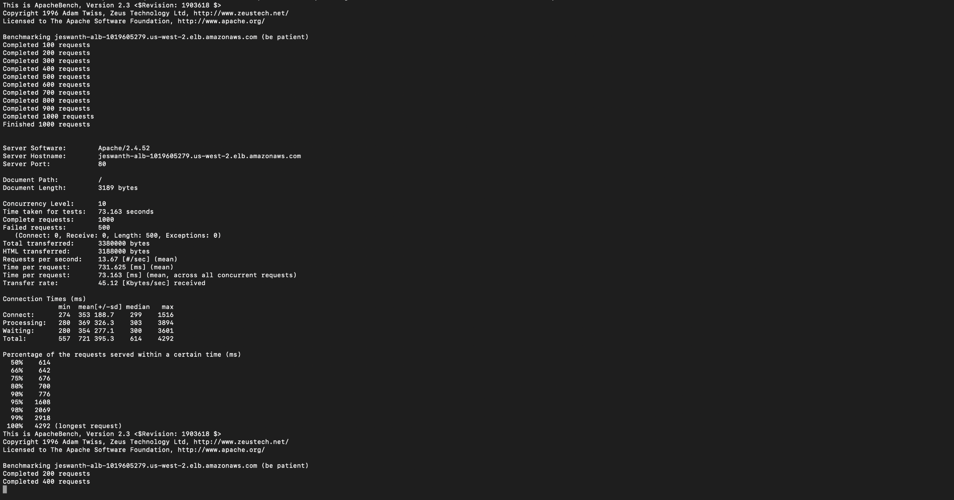
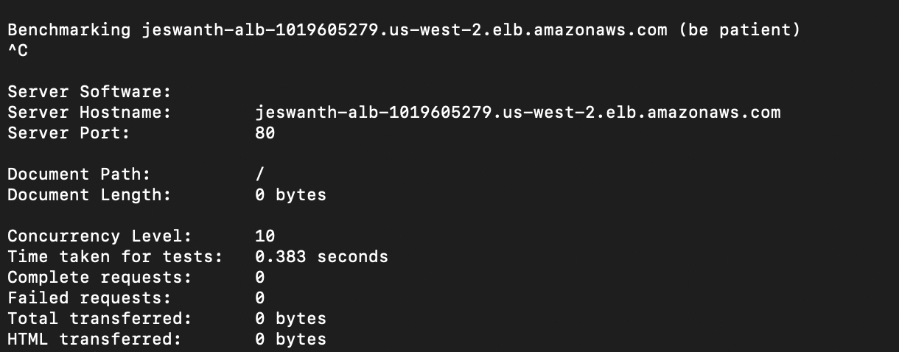
Stress testing our web application :
“for req in 1000 2000 3000 2000 1000; do ab -n $req -c 10 http://3.90.190.44:5000/; done”

Slide 29
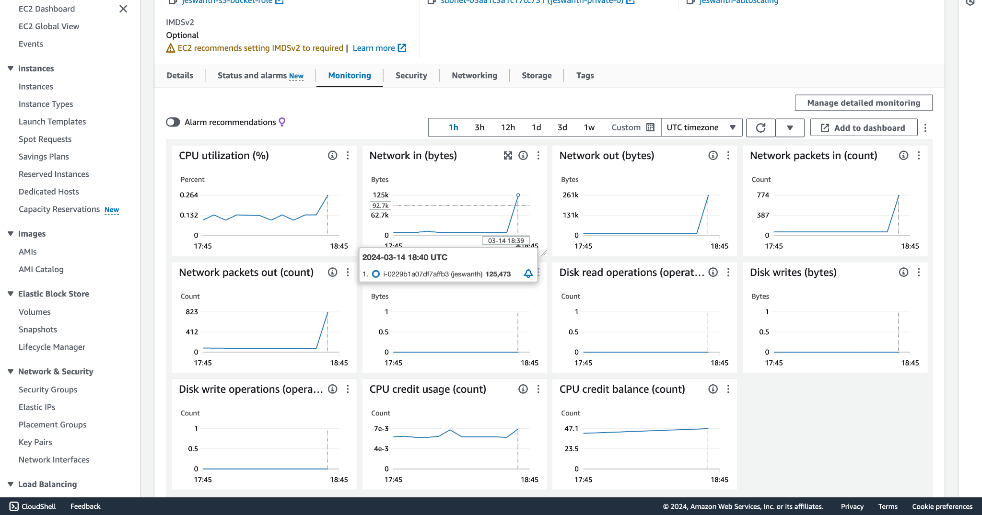
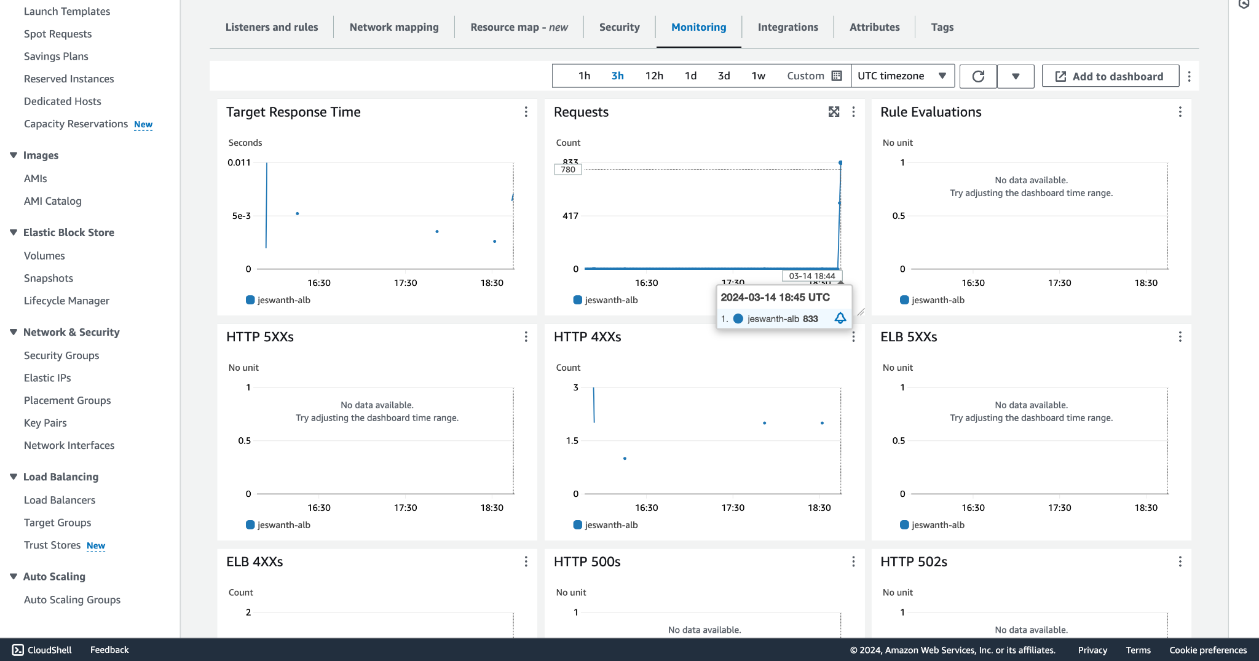
Stats after stress test:

Slide 30
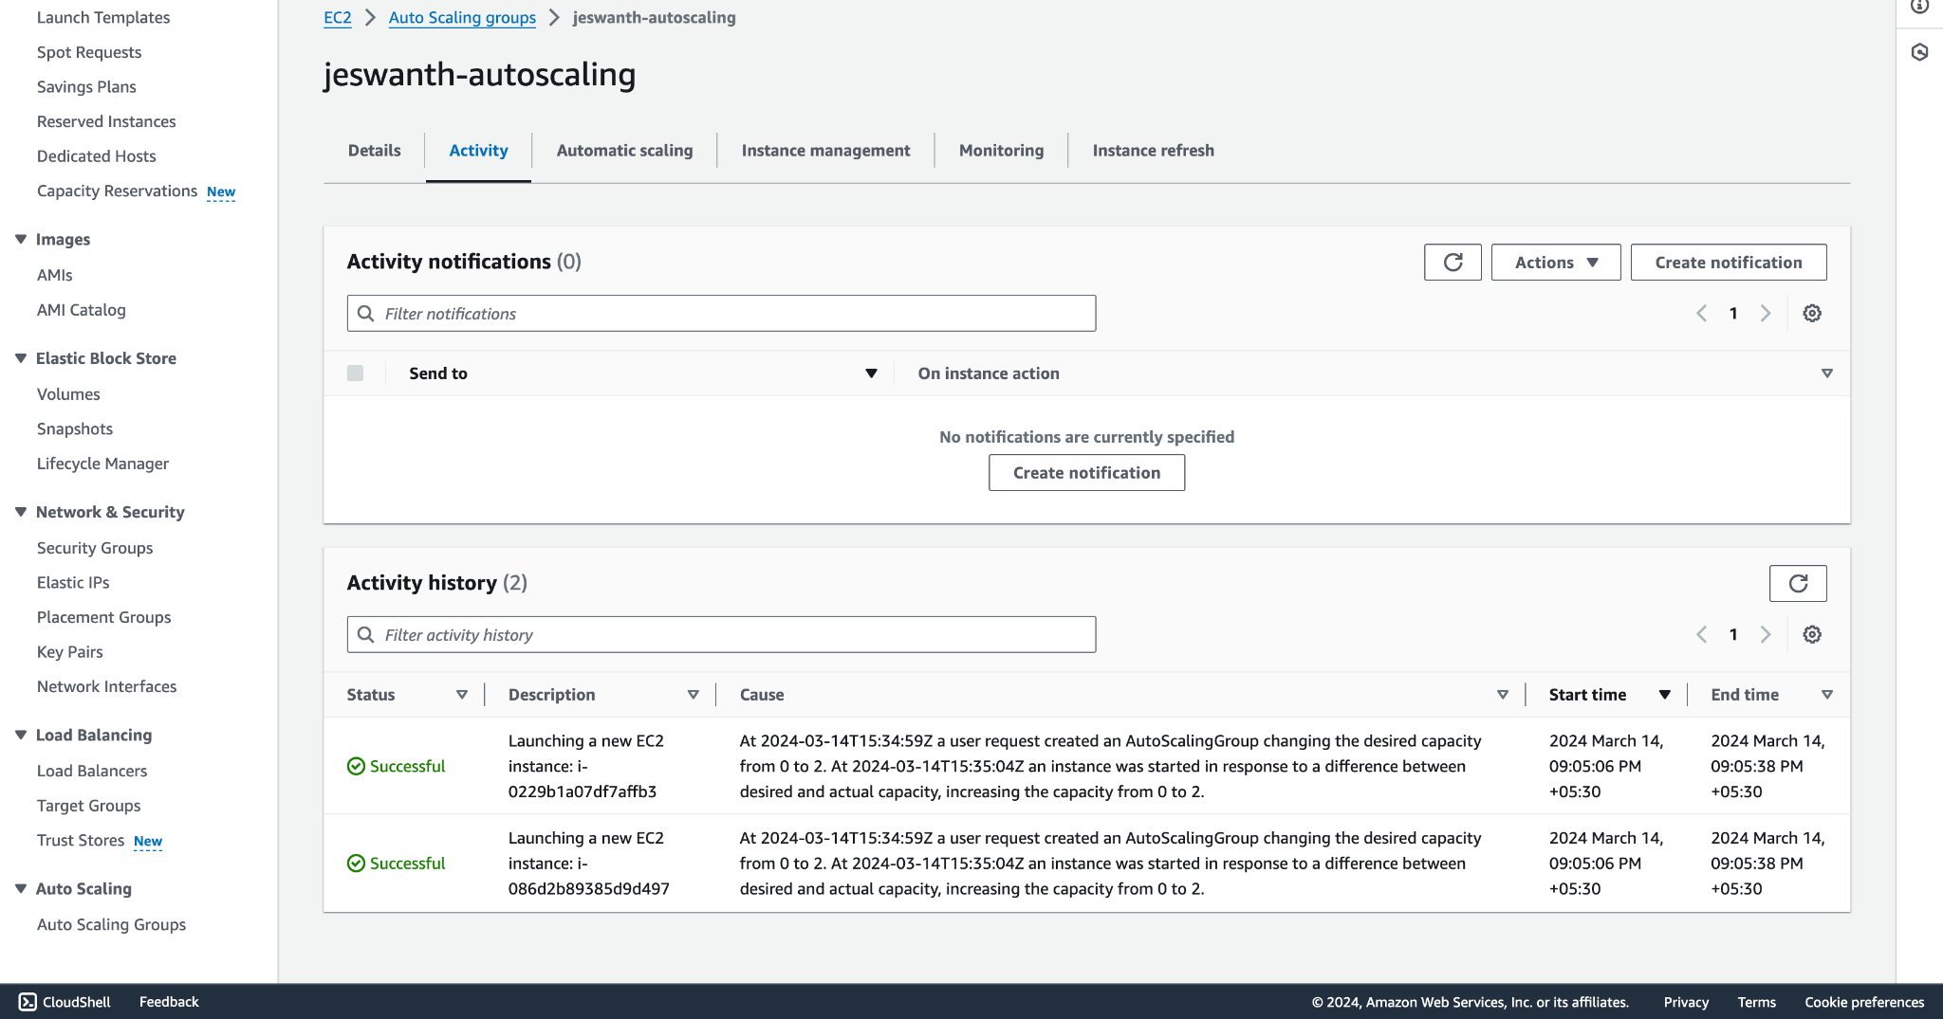

Trigger for Auto-Scaling:
One of the instances is going to an unhealthy state causing a new EC2 instance to get initialized with the help of our launch template.

Slide 31



Slide 32

Auto-Scaling group showing the creation of the new instance is successful

Slide 33

Our web application is stable in this whole process of Load Testing, termination, creation.

Slide 34
Thank you ☺

